Slide 1
VAT and Islamic finance Challenges and policy approaches
Sixth Meeting of the Middle East/North Africa Tax Forum - Doha
Mohammed Amin
November 2015

Slide 2
Presentation outline
Disclaimer
Project organisation
Recap on VAT
Four modelled transactions
VAT issues
Individual country approaches
Principal recommendations
Q & A
All VAT in examples at 20% for simplicity

Slide 3
Disclaimer
Taxation is a complex subject and almost all issues require specific professional advice.
Nothing in this presentation is intended to constitute professional advice.
The speaker accepts no responsibility to anyone who may act, or refrain from acting, as a result of anything shown or said during this presentation.

Slide 4
Project organisation

Slide 5
Participants and goals
Sponsored by Qatar Financial Centre
Organised by International Tax and Investment Center
Principal researcher Mohammed Amin
Outputs
Report on VAT and Islamic finance
This presentation

Slide 6
Project path
Project initiated in 2011 – with goal to
Identify tax obstacles to Islamic finance
Provide policy recommendations
Project team – Mohammed Amin, Hafiz Choudhury and Salah Gueydi
Phase I completed in 2013 with London workshop
Phase II now builds on Final Section of Phase I Report
Focus on VAT and cross border tax treatment

Slide 7
VAT approach in Phase II
Theoretical analysis
Informed by country reviews
South Africa
Singapore
Malaysia
All three have specific VAT legislation for Islamic finance
United Kingdom
Governed by European Union harmonised VAT law
No specific VAT legislation for Islamic finance

Slide 8
Sponsor: Qatar Financial Centre
The Qatar Financial Centre (QFC) is an onshore business and financial centre located in Doha, providing an excellent platform for firms to do business in Qatar and the region. The QFC offers its own legal, regulatory, tax and business environment, which allows 100% foreign ownership, 100% repatriation of profits, and charges a competitive rate of 10% Corporate Tax on locally sourced profits.
The QFC welcomes a broad range of financial and non-financial services firms.
For more information about the permitted activities and the benefits of setting up in the QFC, please visit qfc.qa
@QFCAuthority | #Facilitatingsuccess

Slide 9
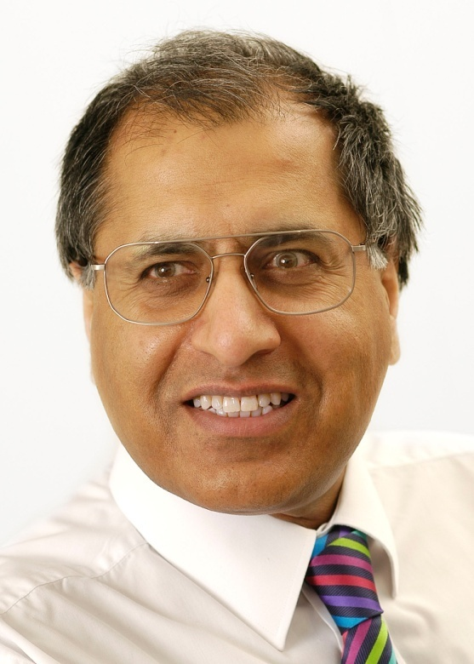
Mohammed Amin
Mohammed Amin is an Islamic finance consultant. Previously he was a partner in PricewaterhouseCoopers LLP and led their Islamic finance practice in the UK.
He is:
a chartered accountant
a chartered tax adviser
a qualified corporate treasurer
Amin has spoken on Islamic finance in over 20 cities covering every continent except Antarctica. Many of his articles and presentations on Islamic finance can be found on his website:
www.mohammedamin.com
Slide 9

Slide 10
Recap on VAT

Slide 11
Value added tax
A tax on value added
Charged at each stage of the production / sales chain
Applies to supplies of goods and services
Borne by the final consumer
Slide 11

Slide 12
The value chain
Wages and profits
50
Mining
business
Price 100
Manufacturing
business
100
Extract raw materials from own mine
Price 150
Wages and profits
Final
consumer
Earth
Slide 12

Slide 13
VAT for miner
Mining
business
Price 100
VAT payable on sales value of 100 at say 20%, tax 20.
Output tax = 20
Tax base 100 = value added in the business.
100
Extract raw materials from own mine
Wages and profits
Earth
Slide 13

Slide 14
VAT for manufacturer
Wages and profits
50
Price 100
Manufacturing
business
Charge 20% VAT on sales price of 150. VAT charged 30.
Output tax = 30
VAT paid on 100 raw materials, 20.
Input tax = 20
Pay net 10 to tax authority.
Price 150
Final
consumer
Suffers VAT of 30 on 150 price
Slide 14

Slide 15
Four modelled transactions
Slide 15

Slide 16
Structures analysed
Islamic finance structure | Conventional analogue
Commodity murabaha / tawarruq | Bank loan
Ijarah sukuk (onshore and offshore SPV) | Issuing a tradable bond
Salaam | Pre-paid committed forward purchase of goods
Istisna | Construction finance

Slide 17
Commodity murabaha or tawarruq
Bank
Immediate sale with deferred payment
Customer
105 paid in 12 months time
100 paid today
Overseas
Murabaha contract
Sale for
immediate
payment
Frontier
Sale for
immediate
payment
100 paid today
Your country
Commodity seller
Commodity buyer

Slide 18
Ijarah sukuk with onshore SPV
Charity
Frontier
Issue sukuk
Pay issue price 100
Investors
Special Purpose
Vehicle (SPV)
Periodical payments representing SPV’s profits 5
Lease
Sell building
Pay price 100
Note: Unwind transactions at end of sukuk not shown.
Pay rent periodically 5
Owner
Your country
Overseas

Slide 19
Ijarah sukuk with offshore SPV
Charity
Issue sukuk
Pay issue price 100
Investors
Overseas
Special Purpose
Vehicle (SPV)
Periodical payments representing SPV’s profits 5
Frontier
Sell building
Pay price 100
Lease
Pay rent periodically 5
Your country
Note: Unwind transactions at end of sukuk not shown.
Owner

Slide 20
Salaam
Bank
Promise to purchase the goods when they become available - wad
Overseas
Frontier
105 paid in 12 months time
Your country
Goods sold and delivered in 12 months time
Goods produced and delivered in 12 months time
100 paid today
Salam contract
Customer seeking
goods in future for
own use or trade,
requiring finance
Supplier of goods capable
of being fully specified
e.g. farmer

Slide 21
Istisna
Overseas
Frontier
Building or ship sold when finished, assume 12 months
Your country
Bank
Customer wanting
building, ship
or similar
105 paid in 12 months time
Second istisna contract
Building or ship, ownership passes when finished
100 paid in stage payments
Note: Here the istisna contracts run for only 12 months. In practice likely to be for longer. Price paid under second contract set to give appropriate profit rate to bank.
Istisna contract
Construction company,
shipbuilder or similar
Note: As an alternative to the second istisna contract, there could be a wad given by the Customer, promising to purchase the building when finished.

Slide 22
VAT issues
Slide 22

Slide 23
Commodity murabaha supplies
Bank
Customer
2
1
3
Commodity seller
Commodity buyer

Slide 24
Salaam supplies
Bank
1
2
Customer seeking
goods in future for
own use or trade,
requiring finance
Supplier of goods capable
of being fully specified
e.g. farmer

Slide 25
Istisna supplies
2
Bank
Customer wanting
building, ship
or similar
1
Construction company,
shipbuilder or similar

Slide 26
Ijarah sukuk supplies
Charity
Does SPV supply land to Investors ?
Investors
Special Purpose
Vehicle (SPV)
Lease
Sell building
1
3
Sale of building by SPV back to Owner – not shown
2
Owner

Slide 27
Key issues
Financial services: taxable or exempt?
Usually exempt
Results in input tax restrictions on banks
Treatment of supplies in Islamic finance transaction
Countries differ in approach
South Africa
Malaysia
UK
Singapore defines Islamic finance to exempt the finance charge

Slide 28
Individual country approaches
Slide 28

Slide 29
United Kingdom (1)
No special rules for Islamic finance
VAT law decided at EU level
Disclosed price increase treated as exempt supply of finance.
VATA Sch 9 Group 5 Item 3
“The provision of the facility of instalment credit finance in a hire-purchase, conditional sale or credit sale agreement for which facility a separate charge is made and disclosed to the recipient of the supply of goods.”
Slide 29

Slide 30
United Kingdom (2)
Supplies of goods in Islamic finance remain taxable
Special rules for terminal markets (commodity warehouses)

Slide 31
UK simple murabaha
2
Bank
Customer
Price = 105
Exempt = 5
Taxable = 100
VAT = 20
Customer pays 120 + 5 =125
1
100 + VAT = 120
Commodity seller

Slide 32
UK commodity murabaha
2
Bank
Customer
Customer pays 120 + 5
Sale for 100
+ VAT 20 if Customer in business
If Customer not in business?
1
100 + VAT = 120
3
Commodity seller
Commodity buyer

Slide 33
Malaysian GST law
Goods and Services Tax Act 2014 section 5
5. Where any person makes a supply of goods or services under an Islamic financial arrangement, any supply made in such arrangement other than the provision of financing shall be treated as neither a supply of goods nor a supply of services.

Slide 34
Malaysia commodity murabaha
2
Bank
Customer
105. No GST
1
100. No GST
100. No GST
3
Commodity seller
Commodity buyer

Slide 35
Malaysia simple murabaha?
2
Bank
Customer
100 + 5. No GST?
Customer would have paid 100+ 20 GST + 5 interest = 125 with conventional loan
1
100. No GST?
Commodity seller

Slide 36
Malaysia simple murabaha as practiced
3
120 + 5 = 125
Bank
Customer
2
120
Bank pays seller 120
1
Seller sells to customer. GST applies. 100 + 20 GST = 120
Commodity seller

Slide 37
South Africa
Value Added Tax Act 1991 section 8A
Bank deemed not to acquire the goods
Client deemed to acquire the goods from seller
Deemed price = amount paid by bank to seller
Markup = exempt financial service

Slide 38
South Africa simple murabaha - actual
Bank
Customer
Sale for 105
GST?
Sale for 100
GST?
Commodity seller

Slide 39
South Africa simple murabaha - deemed
Bank
Exempt financial service 5
Customer
Deemed sale for 100 + 20 GST
Commodity seller

Slide 40
Principal recommendations
Slide 40

Slide 41
Define IF transactions
Key Phase 1 finding
Malaysian government defines what is Islamic finance
UK tax law never mentions Islamic finance
Reason for defining IF transactions
Enables much simpler drafting of tax law
Ensures special tax rules only apply to Islamic finance transactions

Slide 42
Role of regulated entities (1)
Banks and takaful operators are always licensed and regulated.
Require regulated Islamic financial institution (IFI) to certify participation of all its counterparties in IF transaction.
Law can then enable:
Sale from Supplier to IFI without VAT.
Sale from IFI to Customer without VAT.
Sale by Customer to market without VAT if bank acts as Customer’s agent.

Slide 43
Role of regulated entities (2)
Regulated IFI can report all transactions and counterparties to tax authorities.
Minimises compliance risk of permitting Islamic finance sales without VAT when regulated IFI involved.

Slide 44
When no regulated entity?
UK direct tax law for Islamic finance requires a (regulated) financial institution, apart from sukuk provisions.
Otherwise relevant tax provisions not applicable.
Islamic finance between persons in business who are VAT registered basically works.
Use UK approach of treating markups (for payment delays) as exempt supplies.

Slide 45
Participants not in business
What if Customer (retail individual) not in business
See previous commodity murabaha problems.
Proposal:
Enable Customer to charge VAT on his sale, up to amount of VAT paid on Customer’s purchase.
Avoids penalising Customer.
Minimises compliance risk. Customer pays VAT to his supplier, collects only same amount (or less) from person buying from him.

Slide 46
Watch for new developments
Tax authorities need to monitor development of new Islamic finance transactions.
Specific legislation may be required at times.
Islamic finance transactions fall into different logical types.

Slide 47
Categories of IF transactions
Transaction category | Legislators’ approach
Very similar to conventional finance transactions | Special consideration probably not needed.
Peripheral transactions associated with an IF structure | Analyse, check for unexpected problems,
IF transaction has very different structure to conventional transaction | Careful analysis needed to avoid VAT costs for exempt businesses and retail consumers
* Jurisdictions adopting a “legal form” approach are likely to encounter more areas of difficulty than those adopting an “economic substance” approach.
Slide 47

Slide 48
Q&A

