Slide 1
Some tax aspects of SIPPs and charitable giving
Clare College Samuel Blythe Society
Mohammed Amin MBE FRSA MA FCA AMCT CTA(Fellow)
23 May 2020

Slide 2
Outline
Disclaimer
The speaker
Basic tax rules
Giving cash or shares to charity
SIPPs
Planning illustration
Inheritance tax on estate
Q & A

Slide 3
Disclaimer
Taxation, pensions and investing are complex subjects and almost all issues require specific professional advice.
Nothing in this presentation is intended to constitute professional advice.
Neither the speaker nor Clare College accept any responsibility to anyone who may act, or refrain from acting, as a result of anything shown or said during this presentation.
Slide 3

Slide 4
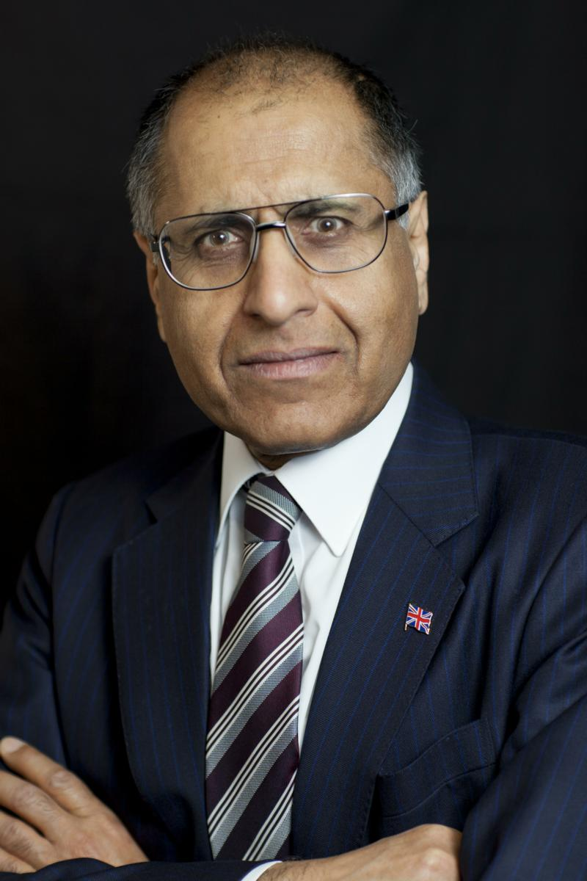
Mohammed Amin (1969)
After graduating in Mathematics, Amin obtained a PGCE from Leeds University, taught for a year, and then trained as a chartered accountant.
Upon qualifying, he specialised in taxation. He joined Price Waterhouse (now PwC) in 1987 as a senior tax manager and was admitted as a partner in 1990, remaining until retirement at the end of 2009.
Many of his articles and presentations on finance (and many other subjects) are on his website: www.mohammedamin.com
Slide 4

Slide 5
Basic tax rules
Slide 5

Slide 6
Tax rates England, Wales & NI 2020-2021
Slide 6

Slide 7
Capital gains tax rate 2020-2021
Slide 7

Slide 8
Giving cash or shares to charity
Slide 8

Slide 9
Assumptions for illustrations
CGT annual exempt amount used up
Asset is listed company shares
Slide 9

Slide 10
Giving cash or shares to charity
Giving cash
Slide 10

Slide 11
Cash donation to charity with gift aid
Slide 11

Slide 12
Giving cash or shares to charity
Shares
Slide 12

Slide 13
Sell shares, pay tax, give remaining cash
Slide 13

Slide 14
Give the shares directly to charity instead
Slide 14

Slide 15
SIPPs
Slide 15

Slide 16
SIPPs
Basic rules
Slide 16

Slide 17
The basic concept
Benefits:
25% tax free lump sum
Purchase annuity
Drawdown with flexible pension withdrawals
Tax free growth
Contributions
You
Contributions
Benefits
You
Complex limits
SIPP
Slide 17

Slide 18
SIPPs
The Lifetime Allowance
Slide 18

Slide 19
Basic idea
Is this too big?
Limit = Lifetime allowance
Tested twice
When benefits crystallised
Again at 75
Tax free growth
Contributions
SIPP
Slide 19

Slide 20
Lifetime allowance
All illustrations use £ 1 million
Slide 20

Slide 21
When benefits crystallised
Excess
Pay tax at 55% + take the money out
Pay tax at 25%, leave money in SIPP
Pay income tax when take the money later
Lifetime
Allowance
SIPP
Slide 21

Slide 22
SIPPs
The Lifetime Allowance
test at age 75
Slide 22

Slide 23
Assumption when benefits crystallised
£ 1,000,000
£200,000 spare LTA
£ 800,000
25% = £200,000 tax free lump sum taken
Lifetime
Allowance
75% = £600,000 retained as drawdown fund
SIPP
Slide 23

Slide 24
At age 75
£800,000
growth
Pay tax at 55% + take the money out
Pay tax at 25%, leave money in SIPP
Pay income tax when take the money later
£600,000 Excess
£200,000 unused LTA
Original £600,000
drawdown
fund
£600,000 original fund
Disaster.
The day before, maximum tax rate on pension was 45%
SIPP
Slide 24

Slide 25
Planning illustration
Slide 25

Slide 26
Illustrative facts
£600,000
Taxable at 55% at age 75
Assume no base cost,
for simplicity
£800,000 not exposed to tax at 75
SIPP
Personal share portfolio
Slide 26

Slide 27
Goals
Reduce exposure in SIPP to tax at 55% at age 75
Need cash available for spending
Donate to charity
Pay as little tax as possible
Slide 27

Slide 28
The plan
£600,000
Taxable at 55% at age 75
£100,000 pension payment, in cash
You
Assume no base cost,
for simplicity
£800,000 not exposed to tax at 75
Give £100,000 worth of shares
Charity
SIPP
Personal share portfolio
Slide 28

Slide 29
What it achieves
Charity receives £100,000 of shares
Eliminates future CGT
Pension fund reduced by £100,000
Reduces exposure to 55% tax at age 75
£100,000 of spendable cash
No tax payable
Slide 29

Slide 30
For £100,000 spendable cash
Idea | Drawbacks
Sell £125,000 shares to have £100,000 cash after 20% CGT. | Charity receives nothing. Pension fund exposure at 55% unchanged.
Take £167,000 pension (spread over several years) to have £100,000 after 40% tax. | Charity receives nothing. The shares held still have a large built in capital gain. Spreading over several years to avoid hitting 45% tax may not be feasible.
Slide 30

Slide 31
Inheritance tax on estate
Slide 31

Slide 32
How inheritance tax works
Your estate
-
£325,000
+ extra £175,000 for residence left to descendants
BUT extra tapered away £1 for each £2 with estates above £2m, so zero for estates above £2.35m.
Nil rate band
x
Tax rate
=
40%
or
36% if at least 10% of estate above nil rate band left to charity
IHT
Slide 32

Slide 33
Effect of leaving 10% to charity
Slide 33

Slide 34
“What if I already plan to leave something to charity, but less than 10%?”
The more you plan to leave to charity (below 10%), the bigger the impact of going up to 10%.
Slide 34

Slide 35
Giving 4% or 10% to charity
Slide 35

Slide 36
Q&A
Slide 36

