Slide 1
The Muslim Jewish Forum of Greater Manchester
The University of Salford
Mohammed Amin MBE
Co-Chair
11 March 2020

Slide 2
Synopsis
About the speaker
Muslims and Jews in the UK – facts and common interests
The Muslim Jewish Forum of Greater Manchester
Design choices
Why it works
What it has done for the speaker
Slide 2

Slide 3
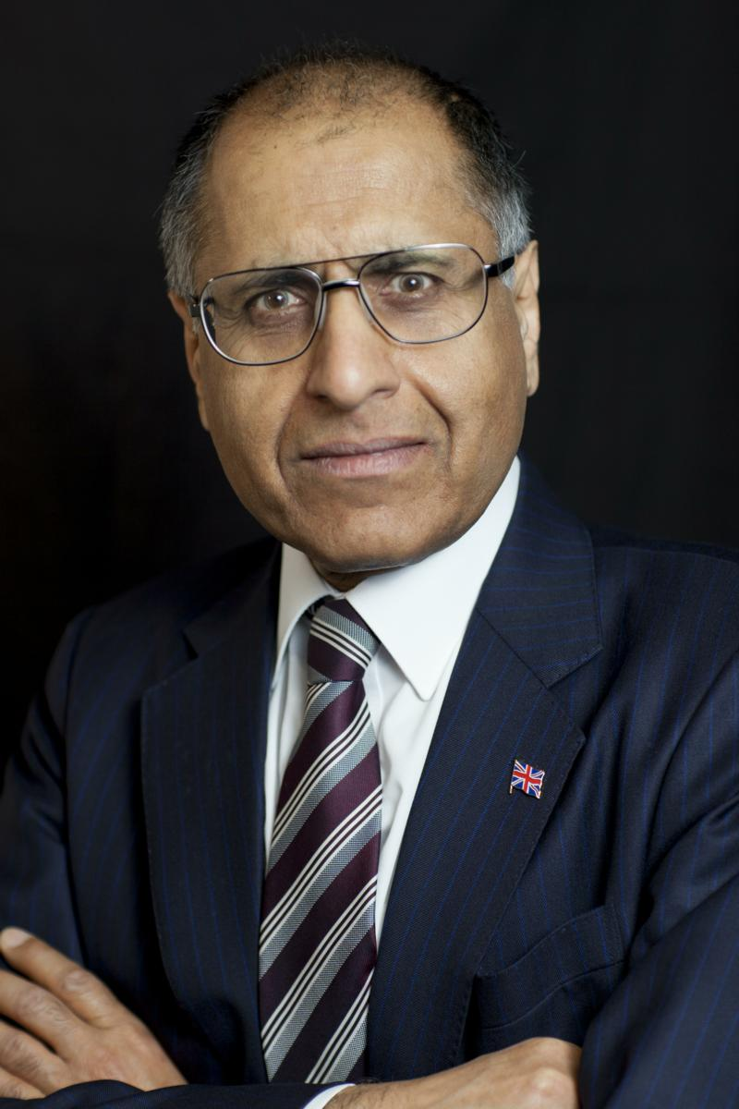
Mohammed Amin MBE
Mohammed Amin has lived in Manchester since the age of 2. He graduated in mathematics from Cambridge University and before retirement was a tax partner in PricewaterhouseCoopers.
Amongst other things, he:
Is Co-Chair of the Muslim Jewish Forum of Greater Manchester
Is Chairman of the Islam & Liberty Network, based in Kuala Lumpur
Was Chairman of the Conservative Muslim Forum, part of the Conservative Party 2014-2020
Was a Member of the University of Salford Council 2012-2014
www.mohammedamin.com
Slide 3

Slide 4
Muslims and Jews in the UK: facts and common interests
Slide 4

Slide 5
Facts
 | Jews | Muslims
Census 2011 England & Wales | 263,000 | 2,700,000
Main period of immigration | 1880 - 1920 | 1960 - 2016
Conversions in | Few | Significant
Parliamentary representation | Proportionately high. Static? | Proportionately low. Growing.
Average educational standards | High | Low. Rising.
Ethnic diversity | Low | Very high
Slide 5

Slide 6
Demographic profiles
Slide 6

Slide 7
Common interests (1)
The right to hold religious beliefs
The right to manifest religious practices
The retention of religious humane methods of animal slaughter for food in the United Kingdom and Europe
The right for young people to be educated in faith schools and to have their religion respected in mainstream schools
Slide 7

Slide 8
Common interests (2)
The retention of male circumcision
The right to have religious observances respected by public bodies and the wider community
The provision of acceptable methods of post mortem examinations
Reproduced from Muslim Jewish Forum declaration of principles
Slide 8

Slide 9
Design choices + Why it works
Slide 9

Slide 10
Design choices
Membership
Purpose
Domestic mission
Sidestepping Israel / Palestine conflict
“the elephant in the room”
Slide 10

Slide 11
Membership
All members are equal
No special role for religious leaders
No civic representations
Everybody is a grass root!
Parity on Executive, two Co-Chairs
Everybody is volunteer
Runs on a shoestring
Slide 11

Slide 12
Purpose – domestic mission
“The objects for which the Forum is established are to develop the cultural and social ties between the Muslim and Jewish Communities of Greater Manchester; to educate members of the Muslim and Jewish Communities in relation to their shared values and common Abrahamic tradition, heritage, history and culture; and to promote better understanding within the wider community of the interests and values that are common to the Muslim and Jewish Communities.”
MJF’s Memorandum of Association
Slide 12

Slide 13
Why it works
Runs on a shoestring
Avoids financial pressures
Accountable to nobody
Put on events that the members like attending
Limited objectives
Get Muslims and Jews in Greater Manchester to get to know each other while attending things
Avoid the divisive Israel / Palestine issue
“not in Greater Manchester”
Slide 13

Slide 14
What it has done for the speaker: - goals - by products
Slide 14

Slide 15
Goals
My life story ➔ God has been incredibly generous to me
Gratitude ➔ Helping others in Manchester, UK and the world
1-1 Mentoring
Running or supporting organisations
Writing, speaking in person, media
Bringing Greater Manchester Muslims & Jews together is part of that
Slide 15

Slide 16
By products
Gained friends in Manchester, both Jews and Muslims
Got to know many national Jewish leaders
Travelled in Europe with Forum (at own expense!)
Learned much about Israel & Palestine, been there twice (not with Forum)
MBE “Founder Member and Co-Chair, Muslim Jewish Forum of Greater Manchester. For services to Community Cohesion and Inter-faith Relations in Greater Manchester.”
Slide 16

Slide 17
Co-Chair Cllr Heather Fletcher
Talk, recorded separately, about the 118 events that the Forum has organised since its formation in 2005
Slide 17

