Slide 1
The relationship between Christianity and Islam
The Co-operative Academy of Stoke-on-Trent
Mohammed Amin MBE FRSA MA FCA AMCT CTA(Fellow)
29 November 2019

Slide 2
Synopsis
The speaker
Religious perspectives
Historical development
Where Christianity and Islam overlap
Where Christianity and Islam differ
Bibliography

Slide 3
The speaker
Slide 3

Slide 4
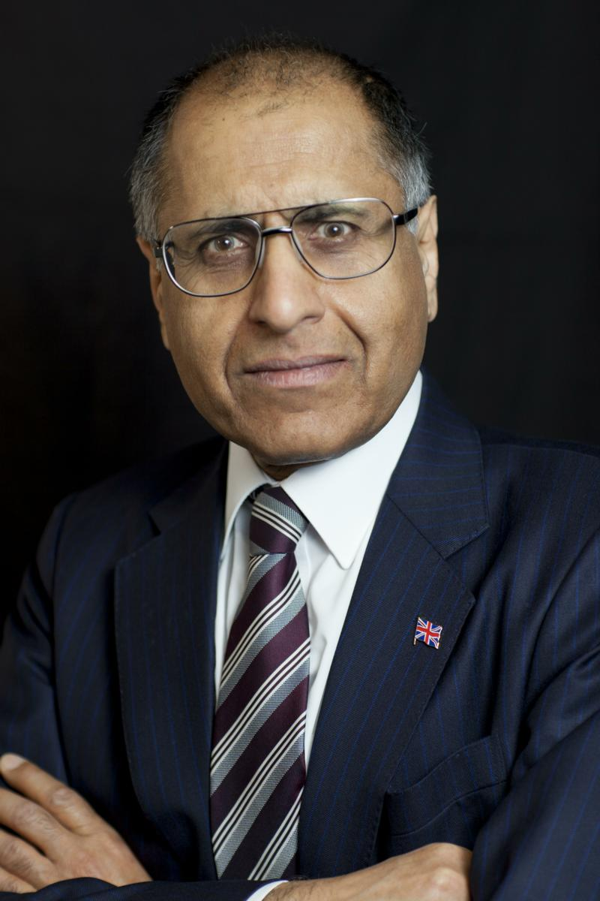
Mohammed Amin
Mohammed Amin has lived in the UK since the age of 2. Amongst other things, he is:
Co-Chair of the Muslim Jewish Forum of Greater Manchester
Chairman of the Islam & Liberty Network, a think tank based in Kuala Lumpur, Malaysia
In June 2016 he was awarded an MBE in the Queen’s Birthday Honours List for services to Community Cohesion and Inter-faith Relations in Greater Manchester.
Most of his previous writings on religion and other topics are on his website:
www.mohammedamin.com
Slide 4

Slide 5
Religious perspectives
Slide 5

Slide 6
Academic vs Believer
Academic | Believer
No divine intervention | Believes God exists
How cultures imagine gods, and why
Prophetic texts always written after the prophesied events | Believes God reveals the future sometimes
Miracles never happened | Miracles happened
Religious texts man made, usually recycling other texts | Texts revealed
Slide 6

Slide 7
Historical development
Slide 7

Slide 8
Faiths around 600 AD
Major Jewish presence
Jerusalem
Mecca and Medina
Major Christian presence
Slide 8

Slide 9
Judaism
Christianity
Islam
All three have to be understood together
Slide 9

Slide 10
Triangulating the Abrahamic faiths
Christianity
Judaism
Islam
Slide 10

Slide 11
Religious texts
Old Testament
New Testament
Quran
Slide 11

Slide 12
Judaism and Christianity
Adam
Noah
Abraham
Moses
Joseph
Malachi
Haggai
Obadiah
Jesus
Slide 12

Slide 13
Judaism, Christianity and Islam
Adam
Noah
Abraham
Moses
Joseph
Jesus
Malachi
Haggai
Obadiah
Jesus
Muhammad
Hud
Saleh
Shuaib
Slide 13

Slide 14
Where Christianity and Islam overlap
Slide 14

Slide 15
Christianity and Islam share
God
Adam, Abraham, Joseph, Moses, King David, King Solomon etc.
The existence of angels
The concepts of heaven and hell
The virgin birth
Muslim virgin birth believers > Christian virgin birth believers?
When?
Slide 15

Slide 16
Where Christianity and Islam differ
Slide 16

Slide 17
Fundamental differences
The nature of Jesus
How salvation comes about
The crucifixion
Slide 17

Slide 18
Jesus in Christian creed
We believe in one Lord, Jesus Christ, the only Son of God, eternally begotten of the Father, God from God, Light from Light, true God from true God, begotten, not made, one in Being with the Father.
Through him all things were made. For us men and for our salvation, he came down from heaven:
Nicene Creed from Vatican website (extract only)
Slide 18

Slide 19
Quran on nature of Jesus
AND LO! God said: "O Jesus, son of Mary! Didst thou say unto men, 'Worship me and my mother as deities beside God’?” [Jesus] answered: "Limitless art Thou in Thy glory! It would not have been possible for me to say what I had no right to [say]! Had I said this, Thou wouldst indeed have known it! … Nothing did I tell them beyond what Thou didst bid me [to say]: 'Worship God, [who is] my Sustainer as well as your Sustainer.'
Quran 5:116-117 Muhammad Asad translation
Slide 19

Slide 20
Salvation (Roman Catholic)
Christ's death is both the Paschal sacrifice that accomplishes the definitive redemption of men, through "the Lamb of God, who takes away the sin of the world", and the sacrifice of the New Covenant, which restores man to communion with God by reconciling him to God through the "blood of the covenant, which was poured out for many for the forgiveness of sins".
Catechism of the Catholic Church from Vatican website
Slide 20

Slide 21
Salvation in Islam
AND NO BEARER of burdens shall be made to bear another's burden; and if one weighed down by his load calls upon [another] to help him carry it, nothing thereof may be carried [by that other], even if it he one's near of kin.
Hence, thou canst [truly] warn only those who stand in awe of their Sustainer although He is beyond the reach of their perception, and are constant in prayer, and [know that] whoever grows in purity, attains to purity but for the good of his own self, and (that] with God is all journeys' end.
Quran 35:18 Muhammad Asad translation
Slide 21

Slide 22
The crucifixion
and their boast, "Behold, we have slain the Christ Jesus, son of Mary, [who claimed to be] an apostle of God!“ However, they did not slay him, and neither did they crucify him, but it only seemed to them [as if it had been] so; and, verily, those who hold conflicting views thereon are indeed confused, having no [real] knowledge thereof, and following mere conjecture. For, of a certainty, they did not slay him: nay, God exalted him unto Himself - and God is indeed almighty, wise.
Quran 4:157-158 Muhammad Asad translation
Slide 22

Slide 23
Bibliography
Slide 23

Slide 24
Quran translations
For reading
“The Qur’an – a new translation" by MAS Abdel Haleem
For study
"The Study Quran - A New Translation and Commentary" - Edited by Seyyed Hossain Nasr
Slide 24

Slide 25
History of Islam
“In The Shadow Of The Sword: The Battle for Global Empire and the End of the Ancient World” by Tom Holland
"Islam – Past Present and Future" by Hans Kung
Slide 25

Slide 26
Jesus from a Muslim perspective
“Zealot: The Life and Times of Jesus of Nazareth” by Reza Aslan
Slide 26

Slide 27
Q & A
Slide 27

