Slide 1
What many Muslims believe. Why. How to change it.
The National Secular Society
The Neem Tree Forum
Islam & Secular Democracy
Mohammed Amin MBE FRSA MA FCA AMCT CTA(Fellow)
10 September 2022

Slide 2
Synopsis
Disclaimer
About the speaker
What many Muslims believe
Why
Where I stand
Achieving change
Conclusions
2

Slide 3
Disclaimer
The speaker has leadership roles and affiliations with many organisations.
He is speaking in a personal capacity.
None of his views should be attributed to the organisations he is associated with.
3

Slide 4
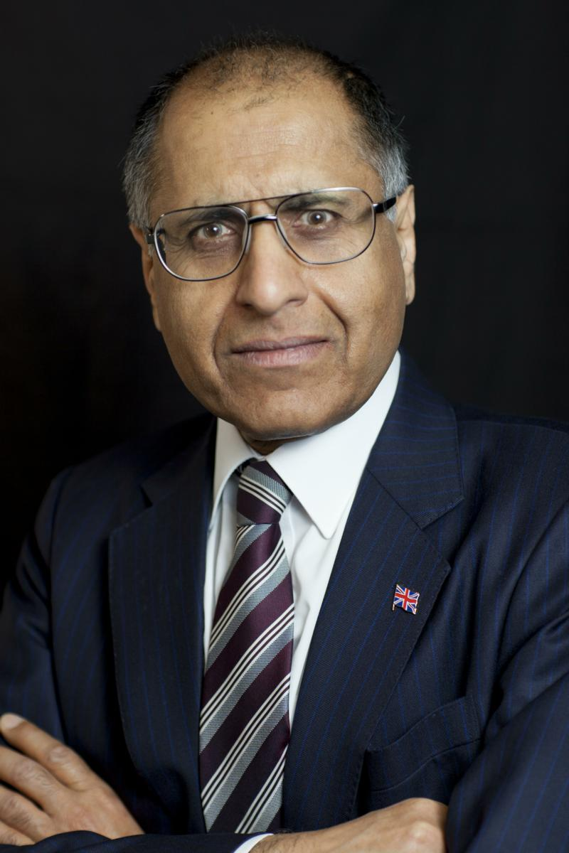
Mohammed Amin
Mohammed Amin has lived in the UK since the age of 2. He graduated in mathematics from Cambridge University and before retirement was a tax partner in PricewaterhouseCoopers.
Amongst other things, he is:
Chairman of the Islam & Liberty Network, based in Kuala Lumpur
Co-Chair of the Muslim Jewish Forum of Greater Manchester
A trustee of The National Muslim War Memorial Trust
A member of the National Secular Society
A member of the Liberal Democrats
For more about the speaker visit:
www.mohammedamin.com
4

Slide 5
What many Muslims believe
5

Slide 6
Widely held views on government
The Quran and Hadith are all that Muslims need
Muslims need a Caliph ruling a united Umma
The state must enforce Islamic law, with some exceptions for Jews and Christians
Voting is shirk (the ultimate sin of associating partners with God)
Recommended reading: “The Islamic Law and Constitution” by Sayyid Abul A’La Maududi, translated by Khurshid Ahmad
https://www.muslim-library.com/dl/books/English_Islamic_Law_and_Constitution.pdf
6

Slide 7
Why
7

Slide 8
Quranic support – some verses (1)
…judgment rests with none but God. He shall declare the truth, since it is He who is the best judge between truth and falsehood. Quran 6:57
Now whenever God and His Apostle have decided a matter, it is not for a believing man or a believing woman to claim freedom of choice insofar as they themselves are concerned: for he who [thus] rebels against God and His Apostle has already, most obviously, gone astray. Quran 33:36
8

Slide 9
Quranic support – some verses (2)
O you who have attained to faith! Pay heed unto God, and pay heed unto the Apostle and unto those from among you who have been entrusted with authority; and if you are at variance over any matter, refer it unto God and the Apostle,… Quran 4:59
All quotes “The Message of the Quran” Muhammad Asad
9

Slide 10
Hadith support
Many Hadith (sayings of the Prophet) about Government
Sahih Muslim (one of the two main Hadith collections) includes a whole book on Government
Next quote from International Islamic University of Malaysia website page
https://www.iium.edu.my/deed/hadith/muslim/020_smt.html
10

Slide 11
Illustrative Hadith
It has been narrated on the authority of Jabir b. Samura who said: I joined the company of the Holy Prophet (may peace be upon him) with my father and I heard him say: This Caliphate will not end until there have been twelve Caliphs among them. The narrator said: Then he (the Holy Prophet) said something that I could not follow. I said to my father: What did he say? He said: He has said: All of them will be from the Quraish.
Sahih Muslim Book 20, Number 4478
11

Slide 12
Where I stand
12

Slide 13
NSS page: What Our Members Say
I joined to show that being an NSS member is compatible with being a Muslim. I think the NSS would benefit from having more members of faith. At present, just as many believers fail to understand what secularism means, many who do not practice a religious faith fail to understand the provisions that a just society needs to make for people who do.
Mohammed Amin MBE, Manchester
13

Slide 14
Achieving change
14

Slide 15
Some tools
Each of us is individually accountable to God.
Responsibility to:
Read the Quran
Read the Hadith collections
Learn Islamic history
What you find does not help the theocrats
15

Slide 16
Conclusions
People’s religious views matter to them.
Only they can change them.
Sharing knowledge and perspectives can help.
16

