Slide 1
Do all Muslims think the same? Understanding the diversity of British Muslims
Council for Christian Muslim Relations (High Wycombe)
Mohammed Amin MBE FRSA MA FCA AMCT CTA(Fellow)
21 February 2018

Slide 2
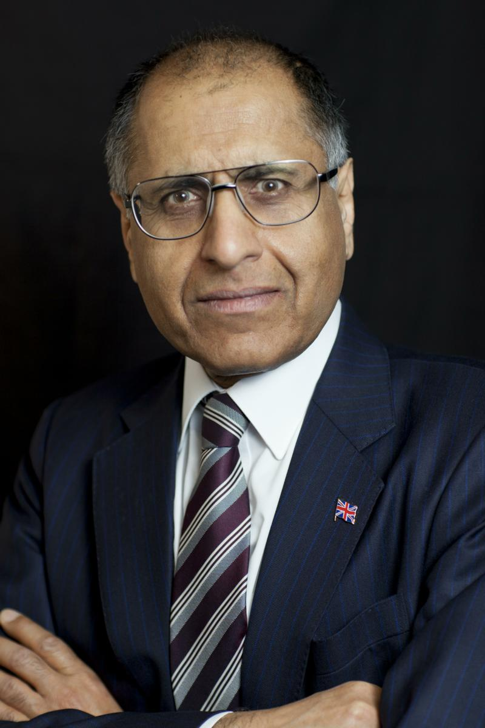
Mohammed Amin
Mohammed Amin has lived in the UK since the age of 2. He graduated in mathematics from Cambridge University and before retirement was a tax partner in PricewaterhouseCoopers.
Amongst other things, he is:
Chairman of the Conservative Muslim Forum, part of the Conservative Party
Co-Chair of the Muslim Jewish Forum of Greater Manchester
A patron and Chairman of Curriculum for Cohesion
A Council Member of the Istanbul Network for Liberty
In 2016 he was awarded an MBE for services to Community Cohesion and Inter-faith Relations in Greater Manchester.
Many of his presentations and writings on religion are on his website www.mohammedamin.com
Slide 2

Slide 3
Outline
A test
Muslim demographics
Theological diversity
My message for Christians
My message for Muslims
Q&A
Slide 3

Slide 4
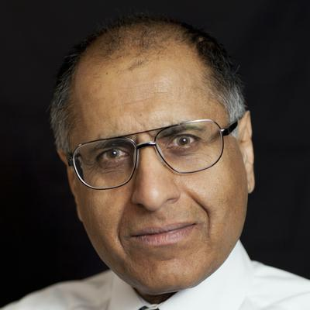
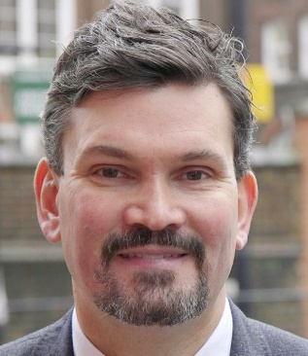
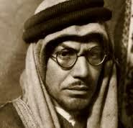
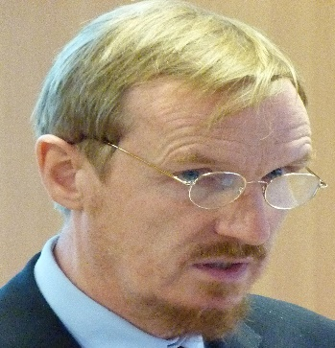
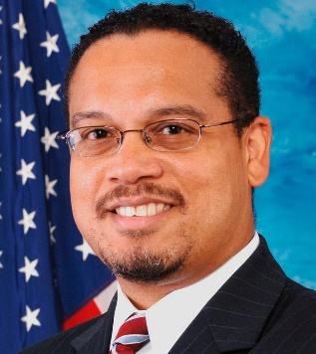
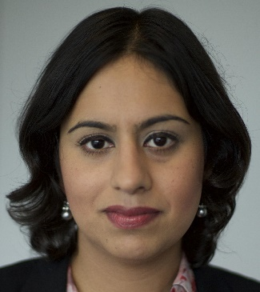
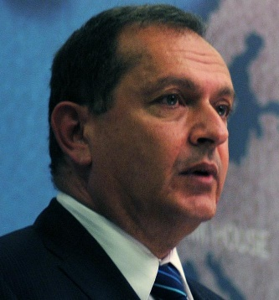
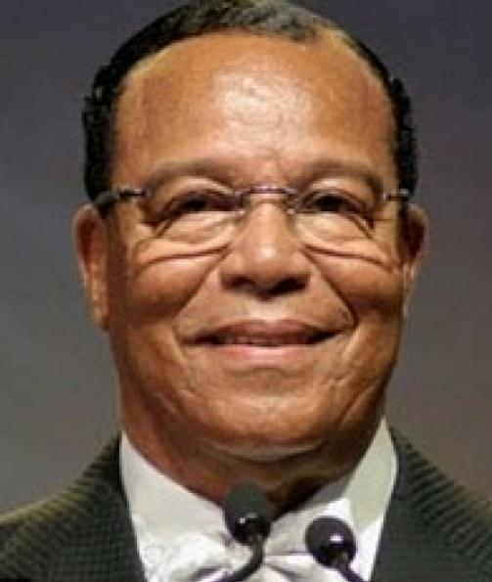
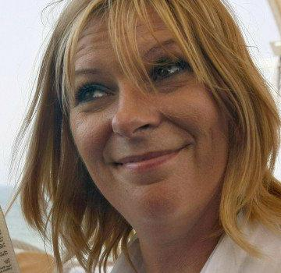
Can you pick out the Muslims?
Slide 4

Slide 5
Can you pick out the Muslims?
Slide 5

Slide 6
Can you pick out the Muslims?
Slide 6

Slide 7
Can you pick out the Muslims?
Slide 7

Slide 8
Can you pick out the Muslims?
Slide 8

Slide 9
Can you pick out the Muslims?
Slide 9

Slide 10
Can you pick out the Muslims?
Slide 10

Slide 11
Can you pick out the Muslims?
Slide 11

Slide 12
Who they are
Mohammed Amin | Dr Matthew Wilkinson, former Head Boy at Eton. | Muhammad Asad, born as Leopold Weiss, author of “The Road to Mecca.” | Tim Winter, aka Shaykh Abdal Hakim Murad, Dean of Cambridge Muslim College. | Congressman Keith Ellison (Democrat, Minnesota)
Sara Khan, lead Commissioner for Countering Extremism. | Simon Collis CMG, UK Ambassador to Saudi Arabia | Kristiane Backer, author of “From MTV to Mecca: How Islam Inspired My Life” | Louis Farrakhan, Leader, Nation of Islam, USA | Lauren Booth, sister in law of Tony Blair.
Slide 12

Slide 13
Muslim demographics
Slide 13

Slide 14
History of Muslims in Britain
Always some
First major wave in 1950’s
Mohammed Amin in 1952
Numbers only estimated until
Census 2001: Great Britain 1.6 million
Census 2011: England & Wales 2.7 million
Slide 14

Slide 15
Ethnic categories
No Turks or Bosnians
Probably in “White other”
No Arabs in 2001
Separate category in 2011
I have treated as part of “other ethnicity”
Slide 15

Slide 16
Slide 16

Slide 17
Muslims by ethnicity
Ethnic group % | 2001 | 2011
White British | 4.1 | 2.9
White other | 7.4 | 4.8
Mixed race | 4.1 | 3.8
Indian | 8.3 | 7.2
Pakistani | 43.2 | 38.0
Bangladeshi | 16.4 | 14.9
Asian other | 5.9 | 7.5
Black African | 6.1 | 7.7
Caribbean | 0.7 | 2.4
Other ethnicity | 3.8 | 10.7
Slide 17

Slide 18
Ethnicity conclusion
Indian sub-continent = about half, but declining
Ethnic diversity of Britain’s Muslims coming to represent global ethnic Muslim diversity
Slide 18

Slide 19
Theological diversity
Slide 19

Slide 20
What my father taught me
Christians are divided into many churches
Muslims all agree about their religion
Slide 20

Slide 21
Islam – Like Christianity, a history of division
Muslims totally united while the Prophet Muhammad (peace be upon him) was alive
He died 8 June 632 AD
Muslims have been divided since then
Slide 21

Slide 22
Sunni / Shia divide
The Prophet Muhammad (pbuh) knew he was mortal.
Who should succeed him?
Closest male relative (and son-in-law) Ali = “party of Ali” (Shia)
Claim that Prophet designated Ali
Best person from amongst leading male Muslims
Chose Abu Bakr
This group known as “Sunnis”
Significant numerical majority
Slide 22

Slide 23
Schools of Islamic law
Founders of four main surviving Sunni schools of thought:
Abu Hanifa (699 AD – 767 AD) – Turkey, India
Malik ibn Anas (711 AD – 795 AD) – North Africa
Shafi (760 AD – 822 AD) – India, SE Asia
Ahmed ibn Hanbal (781 AD – 856 AD) – Saudi Arabia, Qatar etc.
Different geographical predominance, reflected amongst ethnic groups, but not precisely
Slide 23

Slide 24
Responses to modern world
Japan – 1868 Meiji Restoration (not Islam related!)
India – 1866 Darul Uloom Deoband founded to teach more religion
India – 1875 Sir Syed Ahmad Khan founds Mohammedan Anglo-Oriental College (became Aligarh Muslim University 1920) promoting secular education
Similar alternative reactions by other colonised Muslims
Slide 24

Slide 25
Political Islam - Egypt 1928
Officially independent
Unofficially puppet state under British control
Founding of Muslim Brotherhood by Hassan al-Banna 1928
One of two intellectual antecedents of Al Qaeda and ISIS
Slide 25

Slide 26
Political Islam - India
Longstanding British Empire divide and rule approach to Indian religious groups
Writings on Islam by Abul A'la Maududi (1903 – 1979)
Founded Jamaat-e-Islami 1941
Fashionable contemporary ideologies: Fascism, Bolshevism
Maududi created an Islamic version
The other intellectual antecedent of Al Qaeda and ISIS
Slide 26

Slide 27
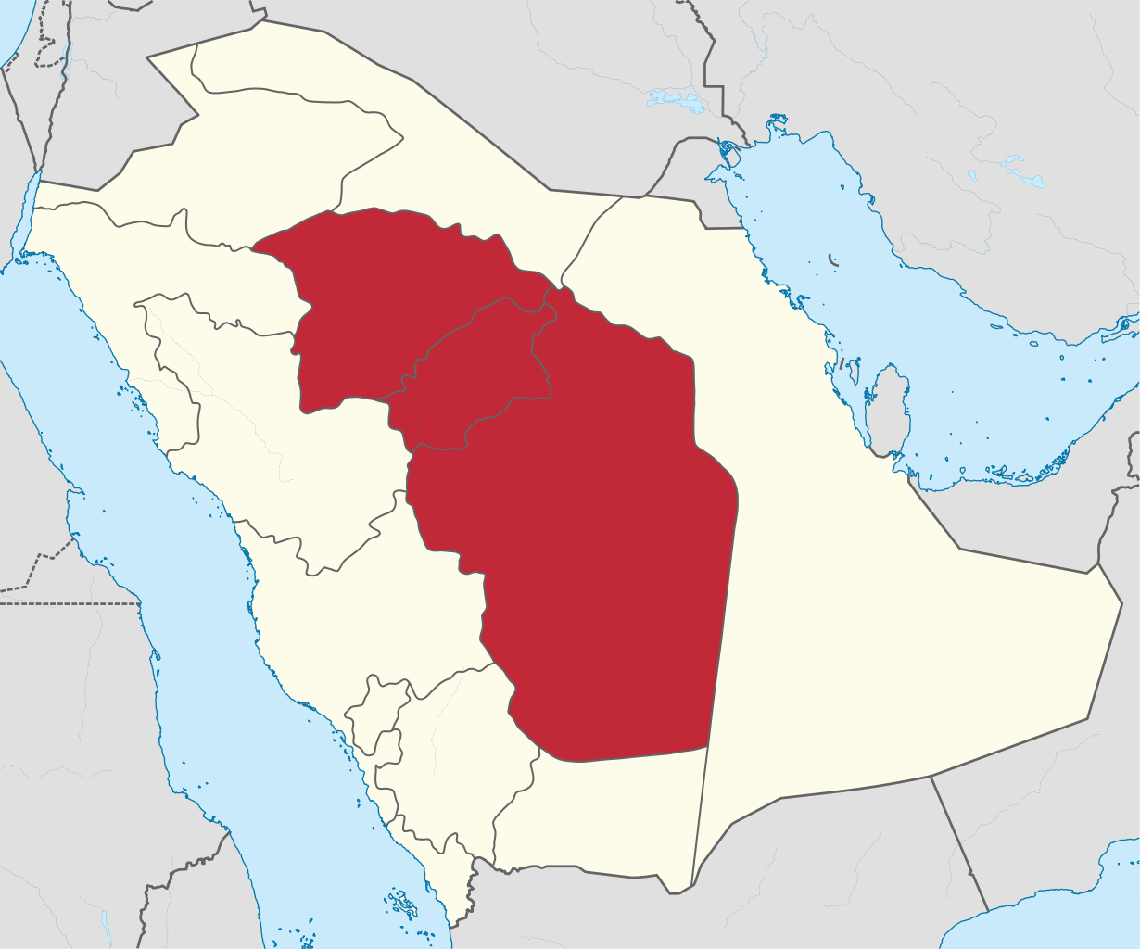
Muhammad ibn Abd al-Wahhab 1703-1792
From Najd in Arabia
No European colonisation
Not even conquered by Ottoman Turks
Religious revivalist
Inspired raids to kill Shias
Slide 27

Slide 28
“Medina in Birmingham, Najaf in Brent: Inside British Islam” by Innes Bowen
The Deobandis: The Market Leaders
The Tablighi Jamaat: Missionaries and a Mega Mosque
The Salafis: ‘Don’t call us Wahhabis!’
The Jamaat-e-Islami: British Islam’s Political Class
The Muslim Brotherhood: The Arab Islamist Exiles
The Barelwis: Sufis and Traditionalists
The Shia ‘Twelvers’: Najaf in Brent
The Ismailis: The Dawoodi Bohras and the Followers of the Aga Khan
Slide 28

Slide 29
British Islam Conference 2018
This weekend 24 & 25 February
Central London, near Old Street
£39 both days (students £15) or one day for £25
Search online, book on billetto.co.uk
Slide 29

Slide 30
My message for Christians
Slide 30

Slide 31
Islam says…..
Slide 31

Slide 32
My message for Muslims
Slide 32

Slide 33
Intra-faith harmony
matters as much as
inter-faith harmony
Slide 33

Slide 34
Q & A
Slide 34

