Slide 1
Welcoming Remarks + Why ILN is vital
8th Islam & Liberty Network Conference
Mohammed Amin MBE FRSA MA FCA AMCT CTA(Fellow)
Chairman
Islam & Liberty Network Council
5 November 2021

Slide 2
Synopsis
The speaker
The world today
Beliefs matter
ILN’s mission
Achieving change
2

Slide 3
The speaker
3

Slide 4
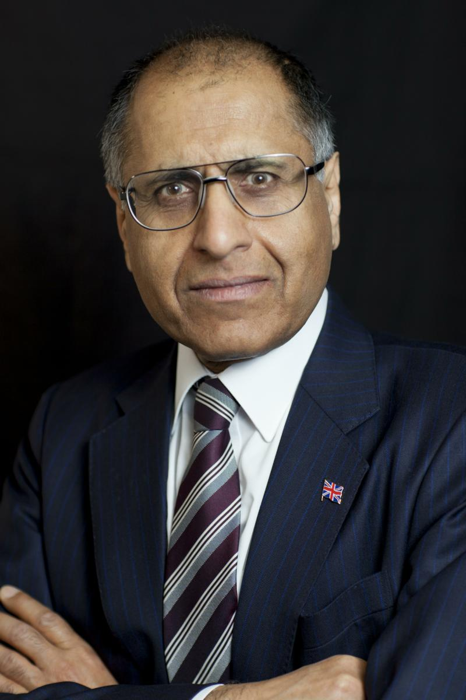
Mohammed Amin
Mohammed Amin was born in Pakistan but has lived in the UK since the age of 2.
Despite poor and illiterate parents, he attended Cambridge University, and became a partner in PricewaterhouseCoopers.
As well as ILN, he is active in many other organisations which are listed on his website’s “About me” page.
He is speaking in a purely personal capacity.
www.mohammedamin.com
4

Slide 5
The world today
5

Slide 6
Countries ranked by GDP per capita
6 oil states
Richer
Muslims tend to be poor
Poorer
OIC members coloured green
6

Slide 7
Freedom matters
Richer
Poorer
More religious, political & economic freedom
7

Slide 8
Beliefs matter
After death
During life
8

Slide 9
History of industrialisation
1
2
2
3
9

Slide 10
Ottoman Turkey v Japan
Ottoman Turkey | Japan
Next door to Europe | 1853 Black ships
Failed to industrialise | 1868 Meiji Restoration
Failed to promote mass literacy | 1904/1905 Defeated Russia in war
“What Went Wrong?: Western Impact and Middle Eastern Response” by Bernard Lewis
Despite title, all about Ottoman Turkey
10

Slide 11
Pakistan v Korea
 | Pakistan | South Korea | Ratio
1950 GDP per person (Source Nationmaster) | $ 650 | $ 876 | 1.3
2013 GDP per capita, PPP, source IMF | $ 4,574 | $ 33,791 | 7.4
11

Slide 12
“Why are Muslim majority countries lagging behind?”
Personal article for ILN
Published September 2020
Key message:
Some religious beliefs are conducive to worldly success; some are not.
Specific example contrasting two Christian groups.
https://islamandlibertynetwork.org/why-are-muslim-majority-countries-lagging-behind-by-mohammed-amin/
12

Slide 13
ILN’s mission
13

Slide 14
The Islam & Liberty Network exists to advance the understanding of religious, political, and economic freedom for peace and prosperity in Muslim majority countries.
14

Slide 15
Achieving change
15

Slide 16
What is needed?
Courage
Speaking is dangerous in many countries
Even in safe countries, risks ostracism
Academic rigour
Our views must be better researched than our opponents
Clarity
The backwardness of Muslim majority countries is no accident
The reasons are internal, not external
16

Slide 17
Alone, each can do something
Together, we can change the world
17

