Slide 1
The worldwide toxification of politics. Your duty as citizens.
Didsbury High School
Mohammed Amin MBE FRSA MA FCA AMCT CTA(Fellow)
30 June 2023

Slide 2
Outline
Disclosures about the presenter
Why government matters
A closer look at government
The worldwide toxification of politics
Your duty as citizens
Q&A
2

Slide 3
Disclosures about the speaker
3

Slide 4
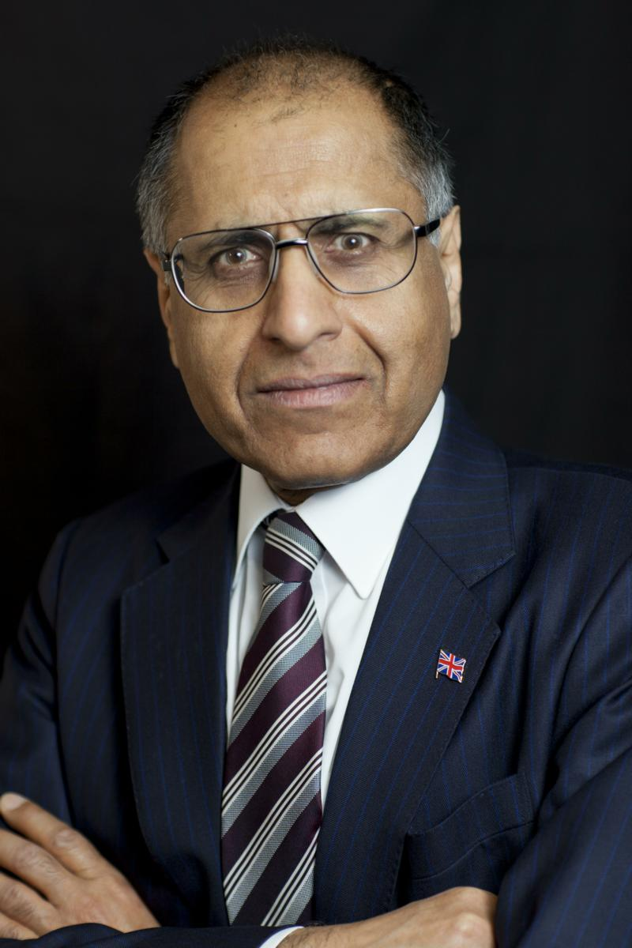
Mohammed Amin
Mohammed Amin was born in 1950 in Pakistan but has lived in Manchester since 1952.
He graduated in mathematics from Cambridge University and before retirement was a tax partner in PricewaterhouseCoopers.
He believes everyone can help to make the world a better place.
His writings and presentations about a wide range of subjects can be found on his personal website.
www.mohammedamin.com
4

Slide 5
My political history
1972-1973 | Socialist Labour League (Trotskyist)
1977-1983 | Liberal Party
1983 – 23 July 2019 | Conservative Party. (Chairman of Conservative Muslim Forum 2014-2019).
October 2019 onwards | Liberal Democrats
5

Slide 6
Why government matters
6

Slide 7
Government quality matters
GDP per capita
 | 1950 | 2023
South Korea | $ 876 | $ 56,706
Pakistan | $ 650 | $ 6,836
South Korea / Pakistan | 1.3 | 8.3
7

Slide 8
A closer look at government
8

Slide 9
What Governments do
Charge taxes | On what? Who pays? How much?
Spend money | On what?
Make laws | What is prohibited? Permitted? Compelled? Where can you build? Can you pollute?
Do things | Defend the country. Fight wars.
Operate a legal system | Enforce your contracts. Say what the law is.
Legislature | Executive | Judiciary
9

Slide 10
Who governs?
Leaders?
Charge taxes | On what? Who pays? How much?
Spend money | On what?
Make laws | What is prohibited? Permitted? Compelled? Where can you build? Can you pollute?
Do things | Defend the country. Fight wars.
Operate a legal system | Enforce your contracts. Say what the law is.
How do some become leaders?
Everyone together?
10

Slide 11
Tensions inside government
Executive
Legislature
Judiciary
11

Slide 12
Read US Constitution
New country
Great thinkers
Short (19 pages)
Easy to find https://constitutioncenter.org/media/files/constitution.pdf and many other places
Where would you find UK Constitution?
Free
12

Slide 13
The Federalist Papers
Written to persuade states to ratify the draft US Constitution
Three “anonymous” authors
Alexander Hamilton (later US Treasury Secretary + hero of a musical)
James Madison (later 4th US President)
John Jay (later 1st Chief Justice of the United States)
85 papers, 656 pages available free download https://files.libertyfund.org/files/788/0084_LFeBk.pdf and many other places
Start with #71 if unsure you can cope!
13

Slide 14
The worldwide toxification of politics
14

Slide 15
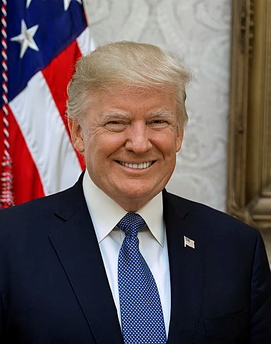
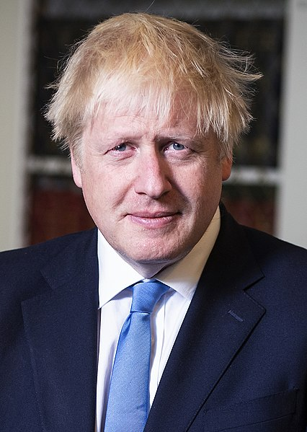
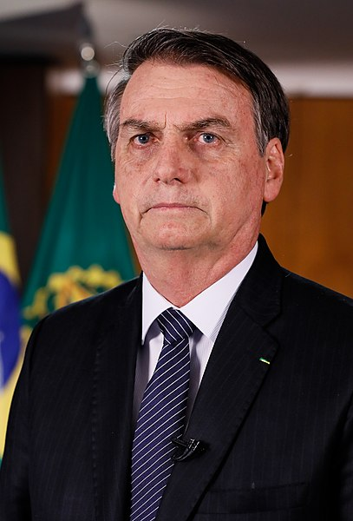
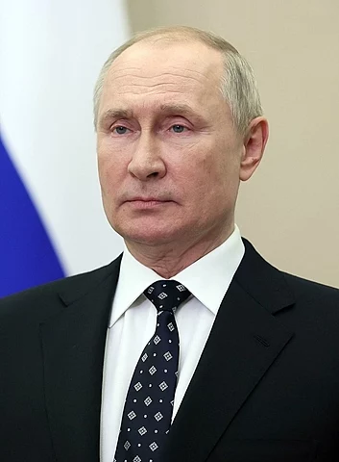
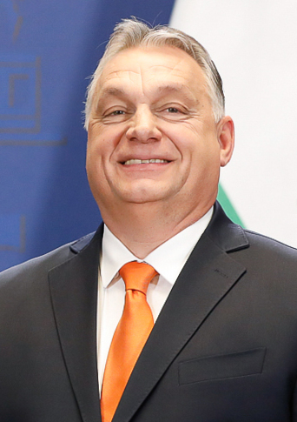
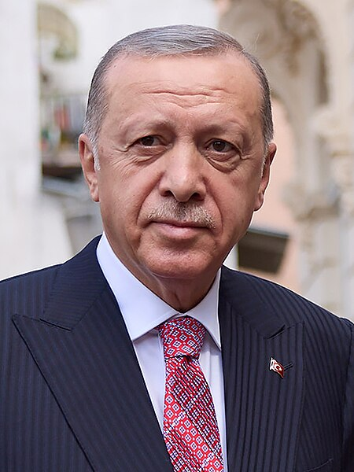
Who are these people?
15

Slide 16
What in common?
Donald Trump USA
Boris Johnson UK
Jair Bolsonaro Brazil
16
Vladimir Putin Russia
Viktor Orbán Hungary
Recep Tayyip Erdoğan Türkiye

Slide 17
The populist playbook
Divide citizens
The true people vs the elites
Loyal Britons vs “citizens of nowhere”
Take control of the media
Eliminate legal checks, take control of the courts
Have elections but make it impossible for opposition to win
“Illiberal Democracy” © Victor Orbán
17

Slide 18
Your duty as citizens
18

Slide 19
Your duty as citizens
Easy
Vote
Be informed – watch & read quality news sources
Pay political party subscription
Give to civil society organisations
Be active supporter of a political party – deliver leaflets etc
Stand for office – councillor, MP.
Needs effort
19

Slide 20
Q & A
20

