Slide 1
The relationship between Judaism, Christianity, Islam
Savio Salesian College
Mohammed Amin MBE FRSA MA FCA AMCT CTA(Fellow)
30 March 2022

Slide 2
Synopsis
The speaker
Ways of thinking about religion:
Believers
Academics
Academic - Historical development
Triangulating the Abrahamic faiths
What you can measure
What you believe
Conclusion
Bibliography
2

Slide 3
The speaker
3

Slide 4
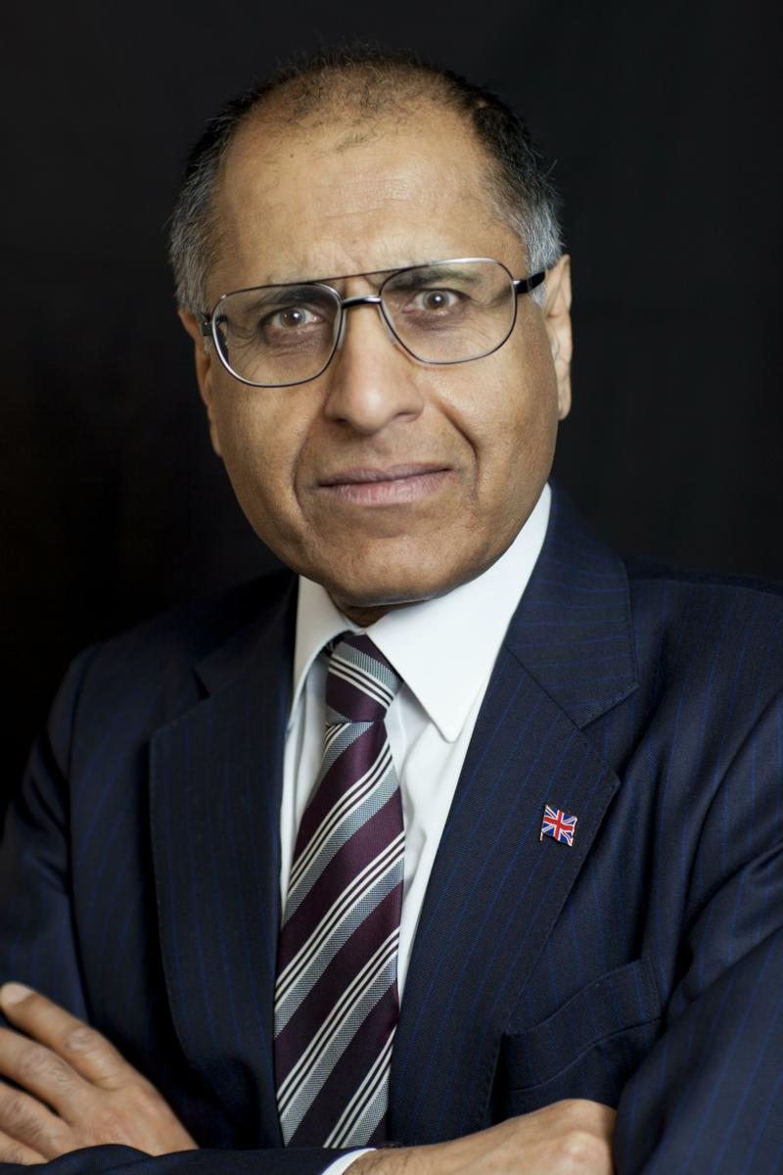
Mohammed Amin
Mohammed Amin has lived in the UK since the age of 2. Amongst other things, he is:
Co-Chair of the Muslim Jewish Forum of Greater Manchester
Chairman of the Islam & Liberty Network, a think tank based in Kuala Lumpur, Malaysia
In June 2016 he was awarded an MBE in the Queen’s Birthday Honours List for services to Community Cohesion and Inter-faith Relations in Greater Manchester.
Most of his previous writings on religion and other topics are on his website:
www.mohammedamin.com
4

Slide 5
Ways of thinking about religion
5

Slide 6
The believer
God
Exists
Can do anything
Sometimes reveals the future
Sometimes makes miracles happen
Sometimes speaks to mankind, recorded in our religious texts
6

Slide 7
The academic
No divine intervention, ever
Study how cultures imagine gods, and why
Prophetic texts always written after the prophesied events
Miracles never happened
All religious texts are man made, usually recycling other religious texts

Slide 8
Academic Historical development
8

Slide 9
A small unimportant region
9

Slide 10
The world’s religion(s)
10

Slide 11
Abraham
Now the Lord said to Abram, Go out from your country and from your family and from your father's house, into the land to which I will be your guide: And I will make of you a great nation, blessing you and making your name great; and you will be a blessing:
To them who are good to you will I give blessing, and on him who does you wrong will I put my curse: and you will become a name of blessing to all the families of the earth. So Abram went as the Lord had said to him, and Lot went with him: Abram was seventy-five years old when he went away from Haran.
Genesis 12:1-4 Basic English Bible
11

Slide 12
Judaism
Christianity
Islam
12

Slide 13
The region around 600 AD
Major Jewish presence
Jerusalem
Mecca and Medina
Major Christian presence
Islam emerged from Judaism and Christianity
13

Slide 14
Triangulating the Abrahamic faiths
14

Slide 15
What a senior Christian said to me
Christianity
Islam
Judaism
15

Slide 16
What you can measure
16

Slide 17
Religious texts
Old Testament
New Testament
Quran
17

Slide 18
Prophets: Judaism
Adam
Noah
Abraham
Moses
Joseph
Malachi
Haggai
Obadiah
18

Slide 19
Prophets: Judaism & Christianity
Adam
Noah
Abraham
Moses
Joseph
Malachi
Haggai
Obadiah
Jesus
19

Slide 20
Prophets: Judaism, Christianity & Islam
Adam
Noah
Abraham
Moses
Joseph
Malachi
Haggai
Obadiah
Jesus
Muhammad
Hud
Saleh
Shuaib
20

Slide 21
Who the Quran names
Person | Mentions by name
Moses | 136
Abraham | 72
Jesus | 25
Muhammad | 12
Words counted in Tal Itani translation
21

Slide 22
What you believe
God
22

Slide 23
The nature of God – Judaism
“Hear, O Israel: The Lord our God, The Lord Is One.”
The Shema.
Deuteronomy 6:4,
Holy Scriptures According to the Masoretic Text
23

Slide 24
The nature of God – Islam
SAY: “He is the One God: God the Eternal, the Uncaused Cause of All Being. He
begets not, and neither is He begotten; and there is nothing that could be compared with
Him.”
Quran 112:1-4 Muhammad Asad translation
24

Slide 25
The nature of God – Christianity
But the Godhead of the Father, of the Son and of the Holy Ghost is all One, the Glory Equal, the Majesty Co-Eternal.
Athanasian Creed, extract, Catholic Encyclopedia
25

Slide 26
What you believe
Jesus
26

Slide 27
Jesus in Christian creed
We believe in one Lord, Jesus Christ, the only Son of God, eternally begotten of the Father, God from God, Light from Light, true God from true God, begotten, not made, one in Being with the Father.
Through him all things were made. For us men and for our salvation, he came down from heaven:
Nicene Creed from Vatican website (extract only)
27

Slide 28
Quran on nature of Jesus
AND LO! God said: "O Jesus, son of Mary! Didst thou say unto men, 'Worship me and my mother as deities beside God’?” [Jesus] answered: "Limitless art Thou in Thy glory! It would not have been possible for me to say what I had no right to [say]! Had I said this, Thou wouldst indeed have known it! … Nothing did I tell them beyond what Thou didst bid me [to say]: 'Worship God, [who is] my Sustainer as well as your Sustainer.'
Quran 5:116-117 Muhammad Asad translation
28

Slide 29
Judaism and Jesus
After the Holy Scriptures – obviously!
Possible mentions in the Talmud (Yeshu)
Basically ignored
Just a man.
29

Slide 30
What you believe
Salvation
30

Slide 31
Salvation (Roman Catholic)
Christ's death is both the Paschal sacrifice that accomplishes the definitive redemption of men, through "the Lamb of God, who takes away the sin of the world", and the sacrifice of the New Covenant, which restores man to communion with God by reconciling him to God through the "blood of the covenant, which was poured out for many for the forgiveness of sins".
Catechism of the Catholic Church from Vatican website
31

Slide 32
Salvation in Judaism & Islam
God tells you how to live
The rest is up to you
Islam, very clear Day of Judgment
Afterlife in Judaism a much less clear concept
32

Slide 33
What you believe
Exclusivism
33

Slide 34
Outside the Church there is no salvation
Basing itself on Scripture and Tradition, the Council teaches that the Church, a pilgrim now on earth, is necessary for salvation: the one Christ is the mediator and the way of salvation; he is present to us in his body which is the Church. He himself explicitly asserted the necessity of faith and Baptism, and thereby affirmed at the same time the necessity of the Church which men enter through Baptism as through a door. Hence they could not be saved who, knowing that the Catholic Church was founded as necessary by God through Christ, would refuse either to enter it or to remain in it.
Catechism of the Catholic Church from Vatican website
34

Slide 35
Islam is non-exclusive
VERILY, those who have attained to faith [in this divine writ], as well as those who follow the Jewish faith, and the Christians, and the Sabians - all who believe in God and the Last Day and do righteous deeds - shall have their reward with their Sustainer; and no fear need they have, and neither shall they grieve.
Quran 2:62 Muhammad Asad translation
35

Slide 36
Judaism – God legislates for gentiles
The 7 Noahide Laws
Do establish laws.
Don’t curse God.
Do not practice idolatry.
Do not engage in illicit sexuality.
Do not participate in bloodshed.
Do not rob.
Do not eat flesh from a living animal.
From MyJewishLearning.com
36

Slide 37
Conclusion
37

Slide 38
The real closeness of the three
Christianity
Judaism
Islam
38

Slide 39
Bibliography
39

Slide 40
The Bible
“The New English Bible with The Apocrypha”
Published 1970
“The Revised English Bible”
Revision of the above
Published 1989
“The Unauthorized Version: Truth and Fiction in the Bible” by Robin Lane-Fox
Published 2006
40

Slide 41
The Quran
For reading
“The Qur’an – a new translation" by MAS Abdel Haleem
For study
"The Study Quran - A New Translation and Commentary" - Edited by Seyyed Hossain Nasr
41

Slide 42
Judaism
“This Is My God: The Jewish Way of Life” by Herman Wouk
42

Slide 43
History of Islam
“In The Shadow Of The Sword: The Battle for Global Empire and the End of the Ancient World” by Tom Holland
"Islam – Past Present and Future" by Hans Kung
43

Slide 44
Jesus from a Muslim perspective
“Zealot: The Life and Times of Jesus of Nazareth” by Reza Aslan
44

Slide 45
Q & A
45

