Slide 1
My International Manchester
Manchester Metropolitan University
Mohammed Amin MBE
27 February 2019

Slide 2
Outline
The speaker
Manchester is home
Manchester’s international history
Some data
Manchester today
The danger of parallel lives
Q&A
Slide 2

Slide 3
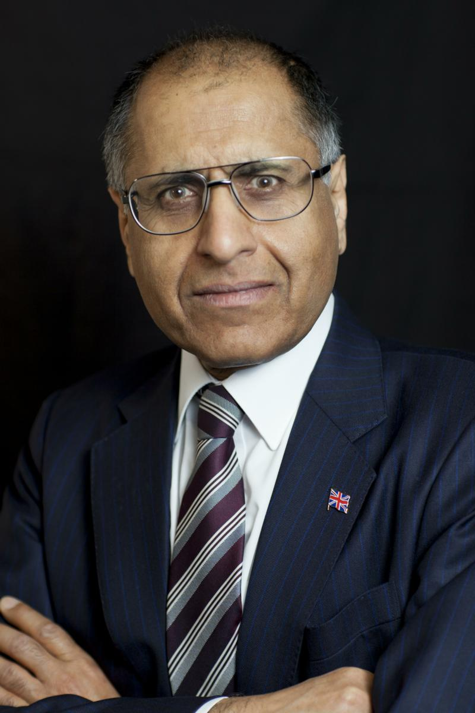
Mohammed Amin MBE
Mohammed Amin graduated in mathematics from Cambridge University and before retirement was a tax partner in PricewaterhouseCoopers.
Amongst other things, he is:
Co-Chair of the Muslim Jewish Forum of Greater Manchester
Chairman of the Conservative Muslim Forum, part of the Conservative Party
A patron and Chairman of Curriculum for Cohesion
Chairman of the Islam & Liberty Network, based in Kuala Lumpur
His writings, and many of his presentations and media appearances, on politics, religion, finance, book reviews, and tips for success are on his website:
mohammedamin.com
Slide 3

Slide 4
Manchester is home
Slide 4

Slide 5
A timeline
Muslim Jewish Forum of Greater Manchester created
Creation of GMEX Exhibition Centre begins
Mother and me come to MAN
Father comes to MAN
1931
1947
1952
1969
1982
1990
2005
Father goes to Pakistan, returning to UK 1950
From Moss Side slum to Clare College Cambridge
2nd ethnic minority, 1st Muslim partner in Price Waterhouse UK
Slide 5

Slide 6
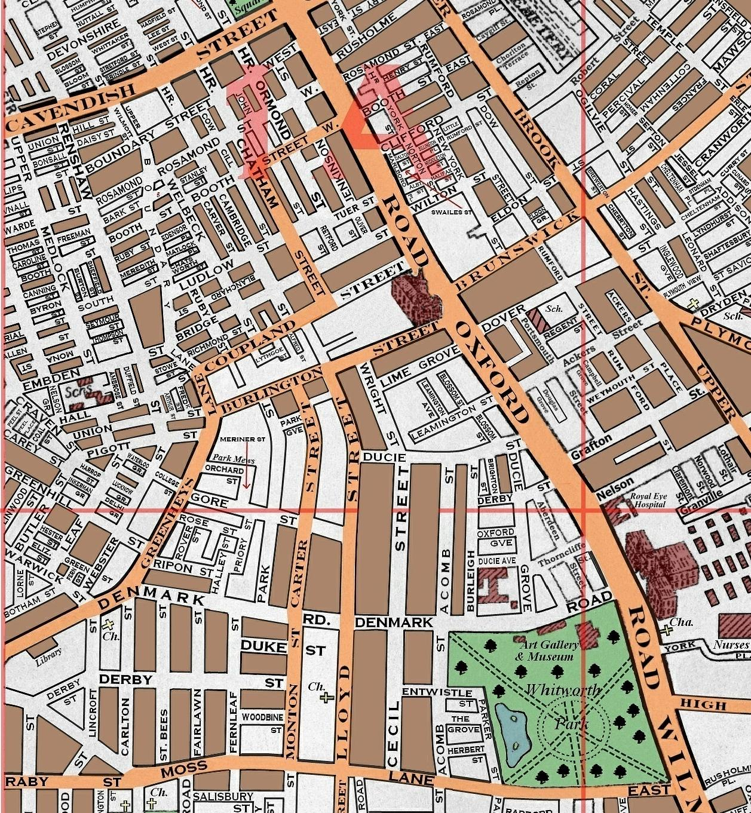
My homeland
1
3
2
4
Slide 6

Slide 7
Manchester’s international history
Slide 7

Slide 8
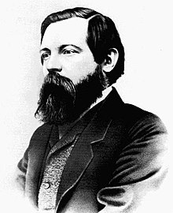
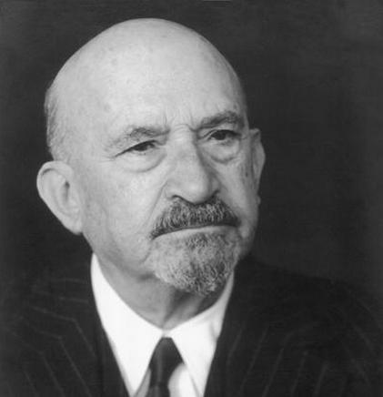
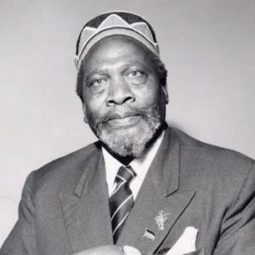
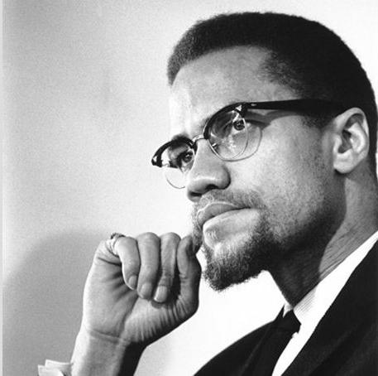
Visitors to Manchester
Friedrich Engels
Chaim Weizmann
Jomo Kenyatta organised 5th Pan-African Congress, Manchester, October 1945
Malcolm X visited Manchester, December 1964

Slide 9
Some data
Slide 9

Slide 10
Manchester’s ethnicity 2011
Ethnic Group | Percentage
White / Irish / Traveller | 66.6
Mixed Race | 4.6
Indian | 2.3
Pakistani | 8.5
Bangladeshi | 1.3
Chinese | 2.7
Other Asian | 2.3
African / Caribbean / Other Black | 8.6
Other ethnic group (includes Arab) | 3.1
Slide 10

Slide 11
Manchester’s religious groups 2011
Religious group | Percentage
Christian | 62.42
Buddhist | 0.55
Hindu | 0.73
Jewish | 0.78
Muslim | 9.12
Sikh | 0.43
Other religions | 0.28
No religion | 15.97
Religion not stated | 9.72
Slide 11

Slide 12
Manchester today
Slide 12

Slide 13
Why Manchester succeeds
Intelligent young people
Top cities have great universities
London, Birmingham, Manchester, Leeds, Cambridge, Oxford
International connections from inward migration
More entrepreneurial risk takers
The power of diaspora connections
Culture & Food
Where do MNC top management want to visit?
Slide 13

Slide 14
The danger of parallel lives
Slide 14

Slide 15
My grammar school
2
150
Slide 15

Slide 16
Some schools today
150
2
Slide 16

Slide 17
Television and video
Before
1-4 channels
All in English
About life in UK
Today
Endless number of channels
Many in foreign languages
About life elsewhere
Slide 17

Slide 18
We make our future
High contact
Low contact
No contact
Slide 18

Slide 19
Q & A
Slide 19

