Slide 1
One Muslim’s perspective on the Israel / Palestine Dispute
Greater Manchester Humanists
Mohammed Amin MBE FRSA MA FCA AMCT CTA(Fellow)
14 March 2018

Slide 2
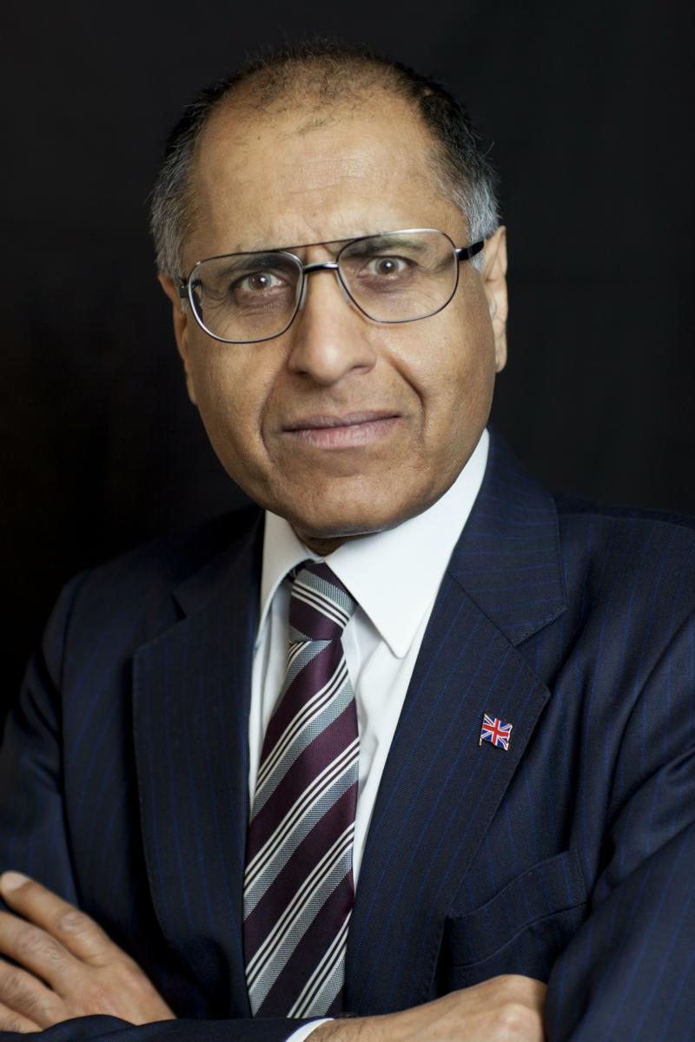
Mohammed Amin
Mohammed Amin has lived in the UK since the age of 2. He graduated in mathematics from Cambridge University and before retirement was a tax partner in PricewaterhouseCoopers.
Amongst other things, he is:
Co-Chair of the Muslim Jewish Forum of Greater Manchester
Chairman of the Conservative Muslim Forum, part of the Conservative Party
Chairman designate of the Istanbul Network for Liberty
His writings and presentations about the Israel / Palestine dispute, and many other subjects, can be found on his personal website.
www.mohammedamin.com
Slide 2

Slide 3
Synopsis
People care about Israel & Palestine
Sanctuary matters
The birth of modern Zionism
A brief history
What if? An alternative history
Where next?
What you can do
Bibliography
Q&A

Slide 4
People care about Israel & Palestine
Slide 4

Slide 5
Should they care?
Against | For
Israel = 150’th country by area | Holiest city for 2.3 bn Christians
Israel = 100’th country by population | 3’rd holiest city for 1.8 bn Muslims
Israel = 33’rd country by GDP | Holiest city for 0.014 bn Jews
Other conflicts have killed many more | Close to Suez Canal & oil states
People care passionately about this conflict for many reasons.
Slide 5

Slide 6
People have strong opinions
@mohammed_amin Tweet 19 June 2017 at 23:44
mohammed.amin.98096721 Facebook status update just afterwards
“I enjoyed attending iftar hosted by Israeli Ambassador Mark Regev at his residence this evening. Good mix of Muslims and Jews present.”
See the Twitter and Facebook responses
Slide 6

Slide 7
People take sides. In general:
Pro - Israeli | Pro - Palestinian
Jews | Muslims
Christian Zionists | Many other Christian groups
Political Left – in past | Political Left - today
Political Right | Former colonial subjects
Slide 7

Slide 8
Sanctuary matters
Slide 8

Slide 9
My early life
Father’s and mother’s villages in Jullundur, now Indian Punjab
Mother refugee during Partition 1947
Becoming a refugee never leaves you
What if Britain expels us?
What Pakistan meant to a small child
Slide 9

Slide 10
Being Jewish
You are always living in someone else’s country
Long European history of persecutions and expulsions
Arab and Turkish Empires less bad
≠ perfect
When nobody will take you in
Voyage of the St Louis May - June 1939
Hamburg ➔ Havana (29 off) ➔ near Florida ➔ near Canada ➔ (UK (288) by boats) ➔Antwerp
Antwerp landers 620, taken by France, Netherlands, Belgium. 254 of these traced to Holocaust deaths.
Slide 10

Slide 11
The birth of modern Zionism
Slide 11

Slide 12
A short history of Europe and Jews
Jews spread throughout Roman Empire. Judaism was a proselytising religion until rise of Christianity.
Christian rule ➔ Jews treated unequally until European enlightenment.
European enlightenment ➔ Equal citizenship
Western European discrimination e.g. Dreyfus Affair
Russia, major pogroms starting ~ 1880.
Slide 12

Slide 13
Modern Zionism
“Der Judenstaat” = “The Jewish State” by Theodor Herzl
We will never be accepted
We have to leave
Our own state
In Palestine or Argentina
No mention of inhabitants
Slide 13

Slide 14
A brief history
Slide 14

Slide 15
History (1)
1917 – British conquer Palestine from Ottoman Empire
1917 – Balfour Declaration.
Slide 15

Slide 16
A brief history
Three quotes from:
“The Balfour Declaration: The Origins of the Arab-Israeli Conflict” by Jonathan Schneer .
Slide 16

Slide 17
A Zionist Jew speaks
“The claim to be Englishmen of the Jewish persuasion – that is, English by nationality and Jewish by faith – is an absolute self-delusion.”
Moses Gaster chapter in “Zionism and the Jewish Future” edited by Harry Sacher, 1916
Slide 17

Slide 18
An anti-Zionist Jew speaks
“Their only claim to the hospitality of Russia, Bulgaria, France, Spain, is that they have no alternative home, no State of their own, and they want to be and are patriotic citizens working for the good of the countries in which they live… When it is known that Palestine is the Jewish State which is really their home then I can forsee a world movement to get them away at any cost.”
Edwin Montagu, Chancellor of the Duchy of Lancaster,
to Prime Minister Herbert Asquith 16 March 1915
Slide 18

Slide 19
The Balfour Declaration
“His Majesty's government view with favour the establishment in Palestine of a national home for the Jewish people, and will use their best endeavours to facilitate the achievement of this object, it being clearly understood that nothing shall be done which may prejudice the civil and religious rights of existing non-Jewish communities in Palestine, or the rights and political status enjoyed by Jews in any other country.”
Letter 2 November 1917 from UK Foreign Secretary Arthur Balfour to Lord Rothschild
Slide 19

Slide 20
History (2)
1929 – Hebron massacre
1936-1939 – Arab revolt
1937 – British partition plan (map follows)
1947 – UN partition plan (map follows)
1948 – War of Independence (map follows)
Slide 20

Slide 21
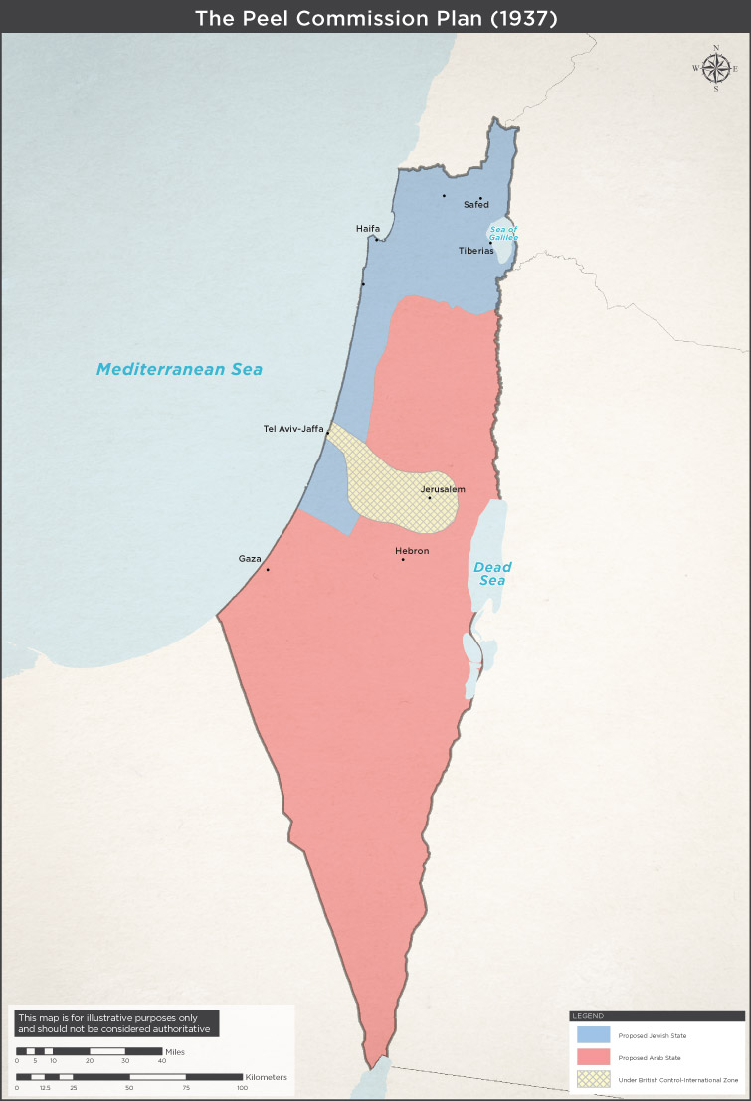
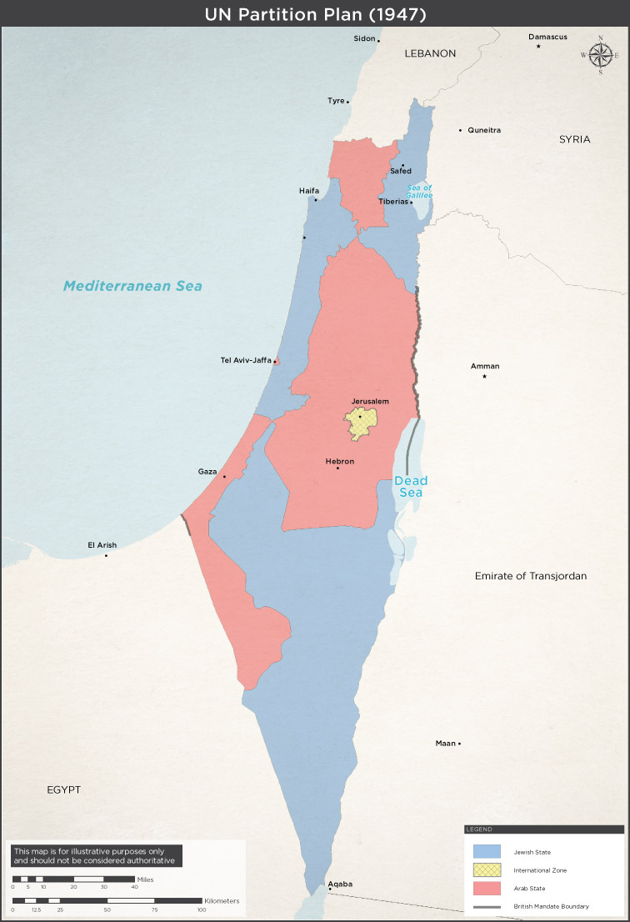
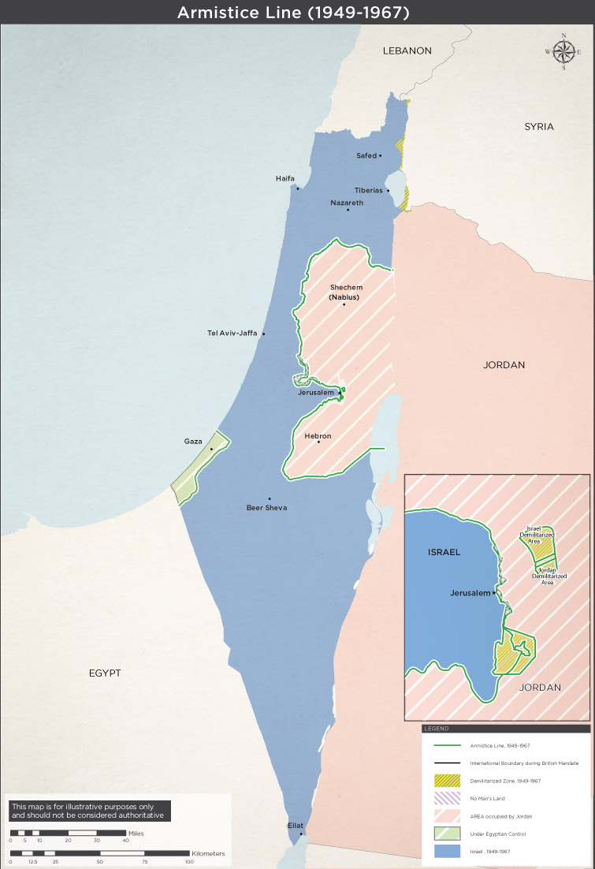
Three maps
Slide 21

Slide 22
History (3)
1967 – Six Day War
1973 – Yom Kippur war
1979 – Egypt / Israel peace treaty
1982 – First Israel / Lebanon war
1987 – Founding of Hamas
1993 – Oslo accords
1994 – Jordan / Israel peace treaty
Slide 22

Slide 23
History (4)
2000 – Start of second Intifada (Uprising)
2005 – Israel evacuates Gaza
2006 – Second Israel / Lebanon War
2007 – Hamas wins Palestinian elections, frozen out
2008 – First Gaza conflict v Hamas
2012 – Second Gaza conflict v Hamas
2014 – Third Gaza conflict v Hamas
Slide 23

Slide 24
What if? An alternative history
Slide 24

Slide 25
Herzl’s other book
“Altneuland” = “Old New Land”
Fiction
How awful Europe is
Wonderful Palestine, Jewish led but with happy advancing Arabs
Fantasy?
Slide 25

Slide 26
What if?
Arabs had never attacked Jews?
Had welcomed Jewish immigration?
Agreed to any partition plan that:
Respected land ownership
Guaranteed equal civil rights
Should being a minority in a state with a Jewish majority bother you?
Slide 26

Slide 27
Where next?
Slide 27

Slide 28
Approximate population numbers
Israel, population ~ 8.5m
75% Jewish, 20% Muslim, 5% other.
Palestinians:
West Bank 2.8m
Gaza 1.8m
Diaspora ~6m, mainly in Arab states
Slide 28

Slide 29
Palestine Liberation Organisation’s objectives
End the occupation
A state comprising West Bank and Gaza
Demilitarisation?
Jerusalem?
Preserve the demand for the right of return
Slide 29

Slide 30
Palestinian acts of self-harm
Promoting hatred of Israel
Honouring terrorists
Paying stipends to families of terrorists
Clinging to the myth of return
Despite Oslo Accords, unwillingness to accept permanence of Israel
Slide 30

Slide 31
Hamas (Islamic Resistance Movement)
The Covenant of the Islamic Resistance Movement 18 August 1988 on Yale Law School website http://avalon.law.yale.edu/20th_century/hamas.asp
May 2017 update on Middle East Eye website http://www.middleeasteye.net/news/hamas-charter-1637794876
Slide 31

Slide 32
Hamas’s objectives
Every cm² of Palestine must be Muslim controlled
Has only ever offered time-limited truce
Slide 32

Slide 33
Hamas hates Jews
The Prophet, Allah bless him and grant him salvation, has said:
"The Day of Judgement will not come about until Moslems fight the Jews (killing the Jews), when the Jew will hide behind stones and trees. The stones and trees will say O Moslems, O Abdulla, there is a Jew behind me, come and kill him. Only the Gharkad tree, (evidently a certain kind of tree) would not do that because it is one of the trees of the Jews." (related by al-Bukhari and Moslem).
Hamas Covenant of 1988, extract from Article 7
Slide 33

Slide 34
Whose actions have the power to destroy Israel?
Slide 34

Slide 35
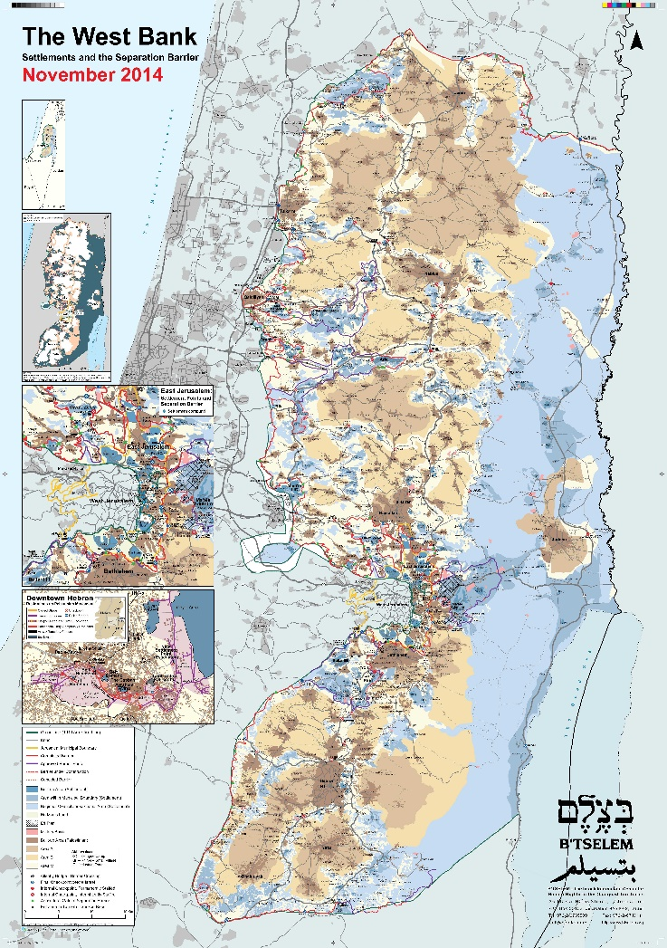
The West Bank today, in detail
B'Tselem – The Israeli Information Center for Human Rights in the Occupied Territories
Founded 1989
Slide 35

Slide 36
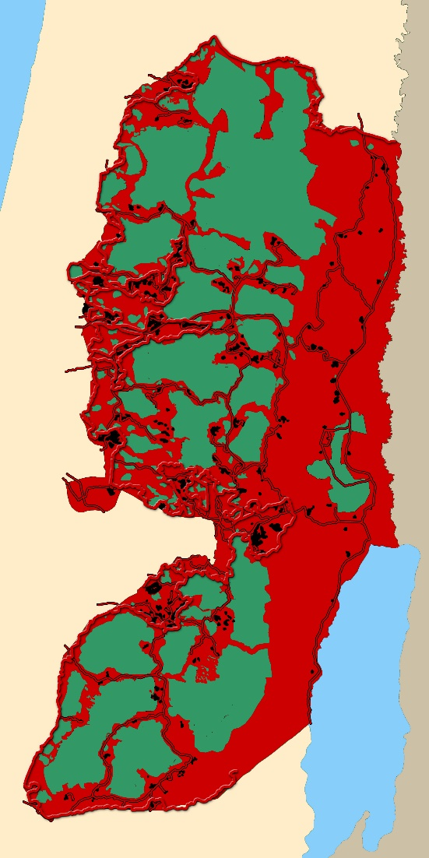
The West Bank today, simplified
Red = areas under Israeli control
From “The Palestine Teaching Trunk” - teaching materials for in western Washington State high schools
Slide 36

Slide 37
Israel’s three objectives
Retain Jewish majority
Have all of Palestine
Remain a democracy
Ranking = my perception of Israeli political trends
Slide 37

Slide 38
A one-state solution?
Often talked about
Unrealistic
Too much bad blood (compare Northern Ireland)
A Jewish majority vital for Jews
Slide 38

Slide 39
What you can do
Slide 39

Slide 40
Be precise with your language
25% of Israeli citizens are not Jewish
20% are Muslim
I call them “the forgotten Israelis”
My vocabulary
Israeli = any citizen of Israel
Otherwise, Israeli Jews / Israeli Arabs
“West Bank Palestinians” / “Gazan Palestinians”
Slide 40

Slide 41
Building shared citizenship in Israel
Israeli Arabs nominally almost equal citizens
Private sector discrimination + some state discrimination
Israeli NGOs need your support. E.g.
The New Israel Fund
The Abraham Fund Initiatives
Merchavim - the Institute for the Advancement of Shared Citizenship in Israel
Oasis of Peace UK: British Friends of Neve Shalom / Wahat al-Salam
Rabbis for Human Rights
Slide 41

Slide 42
Working for Israeli / Palestinian Peace
Many NGOs working to bridge the Green Line (Israel / West Bank) divide. E.g.
Children of Peace
OneVoice Europe
The Bereaved Families Forum
Windows for Peace
Slide 42

Slide 43
Working for balanced debate in UK
CAABU = Council for the Advancement of Arab-British Understanding
FODIP = The Forum for Discussion of Israel and Palestine
Slide 43

Slide 44
Bibliography
Slide 44

Slide 45
Books (1)
"In Ishmael’s House – A History of Jews in Muslim Lands" by Martin Gilbert
“The Invention of the Jewish People” by Shlomo Sand
"The Jewish State" by Theodor Herzl
"Old New Land (Altneuland)" by Theodor Herzl
“The Balfour Declaration: The Origins of the Arab-Israeli Conflict” by Jonathan Schneer .
"The Road to Mecca" by Muhammad Asad
Slide 45

Slide 46
Books (2)
"1948: A History of the First Arab-Israeli War" by Benny Morris
“The Ethnic Cleansing of Palestine” by Ilan Pappe
“Once Upon a Country: A Palestinian Life” by Sari Nusseibeh
"The Israel lobby and US foreign policy" by John J. Mearsheimer and Stephen M. Walt
“Israel and Palestine: Why They Fight and Can They Stop?” by Bernard Wasserstein
"How to Cure a Fanatic – Israel and Palestine: Between Right and Right" by Amos Oz
"Palestinian Walks: Notes on a Vanishing Landscape" by Raja Shehadeh
Slide 46

Slide 47
Q & A

