Slide 1
Will you be poorer than your parents?
Ibstock Place School
Mohammed Amin MBE FRSA MA FCA AMCT CTA(Fellow)
13 November 2017

Slide 2
Outline
My life history
Some of what I do now
Will you be poorer than your parents?
Some interesting facts
Richer than Pharaoh?
Projecting the future
Your real personal challenge
Things to worry about
Q&A
Slide 2

Slide 3
A short life history
Born remote village in Punjab, Pakistan
Grew up in Manchester slums: Chorlton on Medlock, Moss Side
State grammar school + Clare College, Cambridge
Chartered accountant, chartered tax advisor
Second ethnic minority partner in Price Waterhouse, now PricewaterhouseCoopers LLP (“PwC”)
Retired end 2009
Much more at www.mohammedamin.com
Slide 3

Slide 4
Some of what I do now
Slide 4

Slide 5
Pro-bono 1-1 mentoring
Arises randomly
Single encounter v decade long relationship
Slide 5

Slide 6
Leadership role in organisations
Chairman of Conservative Muslim Forum, part of the Conservative Party
Co-Chair of The Muslim Jewish Forum of Greater Manchester
Trustee of charity Curriculum for Cohesion
Council Member of the Istanbul Network for Liberty
Member of Clare College’s Alumni Council
Member of Policy Team at UK Shareholders Association
Grassroots member of many organisations
Slide 6

Slide 7
Sharing my thoughts
Speaking to schools and other audiences
BBC Radio Manchester appearances
Other radio and TV (usually satellite) appearances
Writing on Conservative Home, Islamic Finance News, + elsewhere
My website
Slide 7

Slide 8
Will you be poorer than your parents?
Slide 8

Slide 9
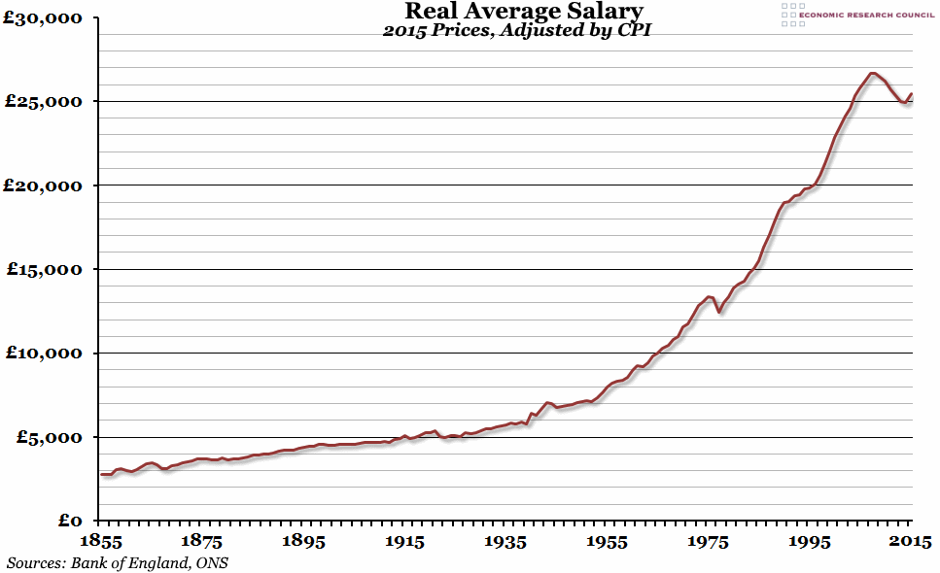
UK Real average salary per capita
Slide 9

Slide 10
My television
2006
Sony flat screen 42 inch HD £2,156
2017
Looking at Samsung 49" Smart 4K Ultra HD HDR QLED £1,399
Slide 10

Slide 11
What I wanted as a teenager
Computer terminal in my bedroom
Connected via a cable to a large computer with the world’s information
Availability in 1960’s?
Cost?
Slide 11

Slide 12
Richer than Pharaoh?
Me v Rameses II of Egypt
What did he have that I don’t?
What do I have that he didn’t?
Who is better off?
Slide 12

Slide 13
Projecting the future
Slide 13

Slide 14
Yogi Berra
“It's tough to make predictions, especially about the future.”
Slide 14

Slide 15
Some trends
1996 IBM’s Deep Blue defeats World Chess Champion Gary Kasparov
2016 Google’s Deep Mind’s AlphaGo defeats Lee Sedol
1950’s Discovery of DNA’s structure
1990’s Decoding human genome
2010’s editing the genome with CRISPR/Cas9
Slide 15

Slide 16
My personal expectations
My 17-year old BMW will probably be the last car I ever own
When I am doddery, my carer will probably be a robot
Material cornucopia awaits
Robots making other robots
Elimination of most genetic diseases
Slide 16

Slide 17
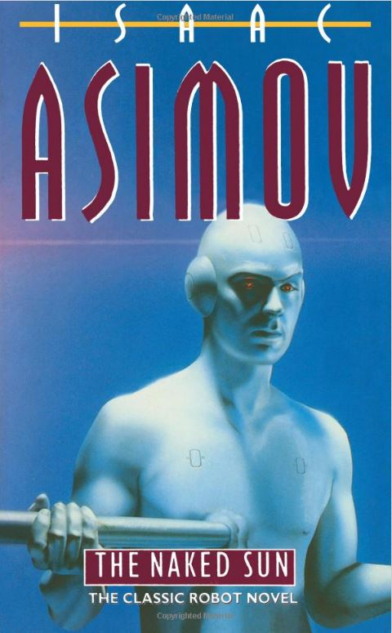
Some saw it coming
“The Naked Sun”
by Isaac Asimov
Written 1957
Slide 17

Slide 18
Your real personal challenge
Slide 18

Slide 19
How do we value ourselves?
I am a ……………….[insert job title of your choice]
What happens when you have no job, but plenty of spending power?
Universal Basic Income
What gives your life meaning?
Slide 19

Slide 20
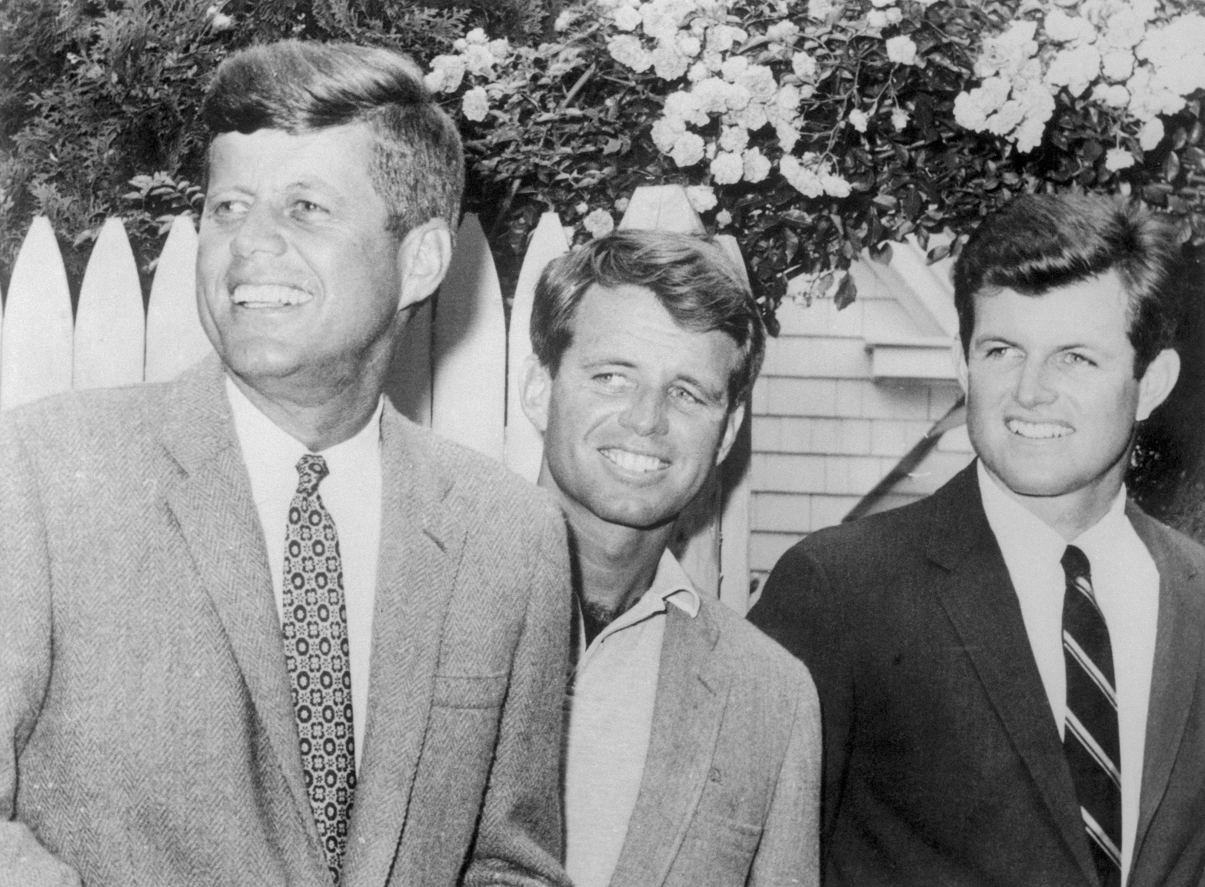
Some have always had this problem
Slide 20

Slide 21
There are still things to worry about
Global warming
Thermonuclear war
Man made plagues
Like everything, CRISPR/Cas9 can be misused
Slide 21

Slide 22
Q & A
Slide 22

