Slide 1
Does the Quran support Zionism? - For the proposition
Manchester Limmud
Mohammed Amin MBE
30 June 2019

Slide 2
Outline
The speaker
Some Quranic texts
All translations from Muhammad Asad “The Message of the Quran”
Commentators on the Quran
Sourced from “The Study Quran” by Syed Hossein Nasr + 3 colleagues
They in turn reference many classical commentaries
Slide 2

Slide 3
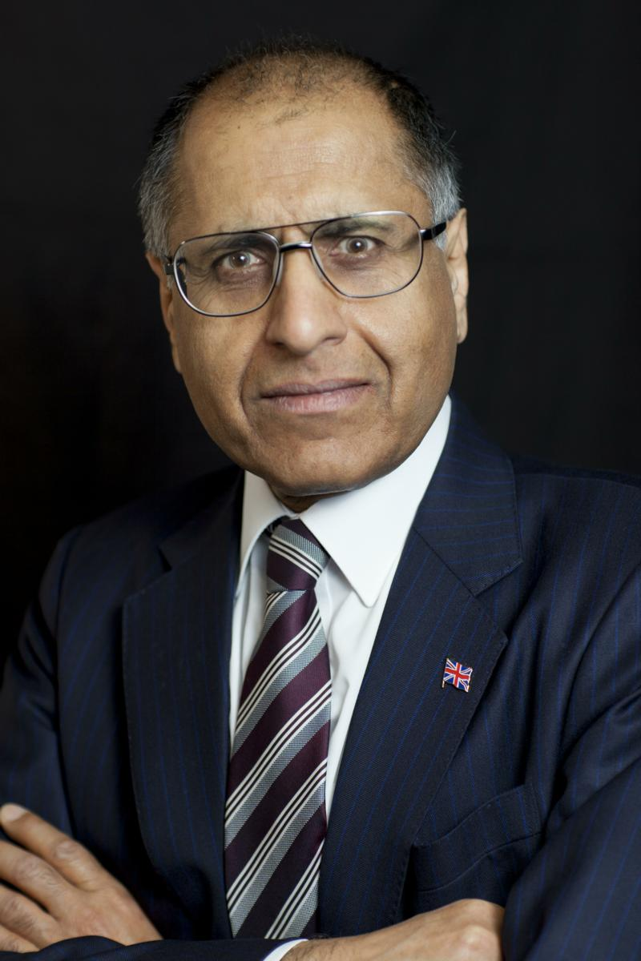
Mohammed Amin MBE
Mohammed Amin has lived in the UK since the age of 2. He graduated in mathematics from Cambridge University and before retirement was a tax partner in PricewaterhouseCoopers.
Amongst other things, he is:
Co-Chair of the Muslim Jewish Forum of Greater Manchester
Chairman of the Islam & Liberty Network
Former Chairman of the Conservative Muslim Forum, part of the Conservative Party
In 2016 he was awarded an MBE for services to Community Cohesion and Inter-faith Relations in Greater Manchester.
His 2016 lecture to Finchley Progressive Synagogue “Muslim-Jewish relations in the UK” and other writings and presentations on the role of religion in society are on his website www.mohammedamin.com
Slide 3

Slide 4
Key Quranic texts
With commentaries
Slide 4

Slide 5
Chosen people
O children of Israel! Remember those blessings of Mine with which I graced you, and how I favoured you above all other people; and remain conscious of [the coming of] a Day when no human being shall in the least avail another, nor shall intercession be accepted from any of them, nor ransom taken from them, and none shall be succoured.
Quran 2:47-48
Slide 5

Slide 6
Israelites given some land somewhere
And [thereafter], indeed, We assigned unto the children of Israel a most goodly abode, and provided for them sustenance out of the good things of life. And it was not until knowledge [of God's revelation] was vouchsafed to them that they began to hold divergent views: [but,] verily, thy Sustainer will judge between them on Resurrection Day regarding all on which they were wont to differ.
Quran 10:93
Slide 6

Slide 7
Commentary on 10:93
Location considered to be in Palestine or Syria. Referenced to:
Abd Allah ibn Umar ibn Muhammad al-Baydawi (d.685/1286), “Anwar al-tanzil wa asrar al-tawil” and
Abu Ali al-Fadl ibn al-Hasn al-Tabrisi (d.548/1153-54), “Majma al-bayan fi tafsir al-Quran”
Slide 7

Slide 8
Where?
whereas unto the people who [in the past] had been deemed
utterly low, We gave as their heritage the eastern and western parts of the land that We had blessed. And [thus] thy Sustainer's good promise unto the children of Israel was fulfilled in result of their patience in adversity; whereas We utterly destroyed all that Pharaoh and his people had wrought, and all that they had built.
Quran 7:137
Slide 8

Slide 9
Commentary on 7:137
Various locations suggested by commentators:
Syria & Palestine
Egypt
Egypt & Syria/Palestine
Slide 9

Slide 10
The Holy Land
O my people! Enter the holy land which God has promised you; but do not turn back [on your faith], for then you will be lost!“ They answered: “O Moses! Behold, ferocious people dwell in that land,” and we will surely not enter it unless they depart therefrom; but if they depart therefrom, then, behold, we will enter it.”
Quran 5:21-22
Slide 10

Slide 11
Commentary on 5:21
Various locations suggested:
Sinai
Syria
Jericho
Parts of Syria, Palestine & Jordan
Sanctuary of Jerusalem
Unknowable, somewhere between Nile and Euphrates, but not all of it!
Slide 11

Slide 12
Until the Last Day
And then Pharaoh resolved to wipe them off [the face of] the earth - whereupon We caused him and all who were with him to drown [in the sea]. And after that We said unto the children of Israel: "Dwell now securely on earth - but [remember that] when the promise of the Last Day shall come to pass, We will bring you forth as [parts of] a motley crowd!"
Quran 17:103-104
Slide 12

Slide 13
Commentary on 17:104
Various locations suggested:
Egypt
Palestine (Canaan)
Both
Motley crowd, either:
Israelites both good and bad or
Israelites + their enemies
Slide 13

Slide 14
Q & A
Slide 14

