Slide 2
Synopsis
About the presenters
Brief introduction to The Muslim Jewish Forum of Greater Manchester
Who is getting COVID-19?
Immediate challenges
Sharing experiences of helping those self-isolating
Brainstorming new ideas
Slide 2

Slide 3
The Presenters
Slide 3

Slide 4
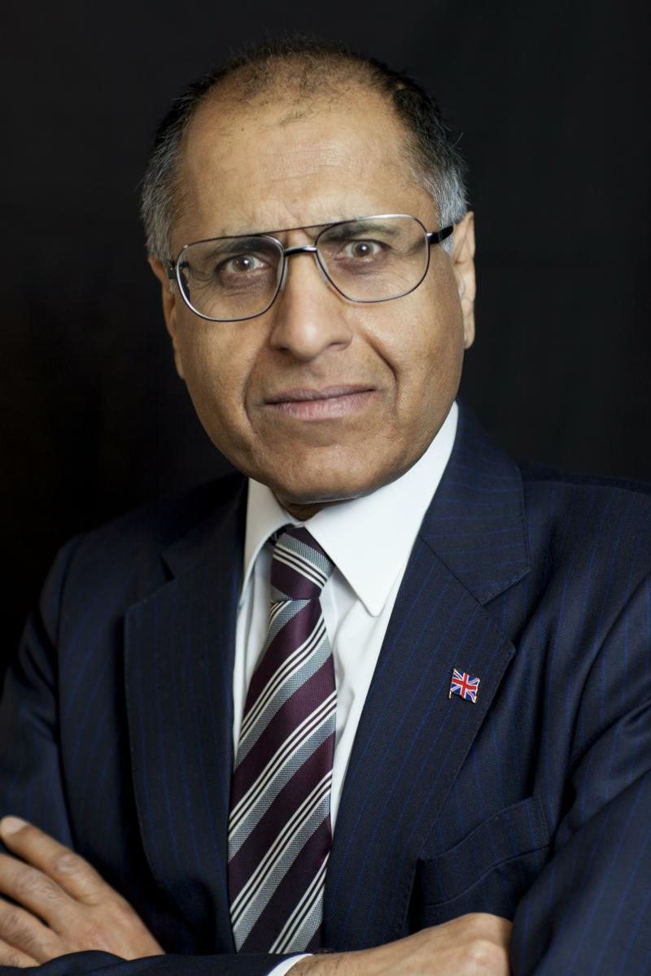
Mohammed Amin MBE
Mohammed Amin has lived in Manchester since the age of 2. He graduated in mathematics from Cambridge University and before retirement was a tax partner in PricewaterhouseCoopers.
Amongst other things, he is:
Co-Chair of the Muslim Jewish Forum of Greater Manchester
Chairman of the Islam & Liberty Network, based in Kuala Lumpur
www.mohammedamin.com
Slide 4

Slide 5
Jonny Wineberg
Jonny Wineberg is a community and interfaith activist and has worked at a senior management level in the public, private and voluntary sector. Since 2006 he has been a Consultant for Not-for-profit Organisations and Visiting Lecturer in Youth Work and Management at Nazarene Theological College.
Amongst other things he:
Is the Founder and Director of Community Futures Trust CIC supporting over 100 organisations since 2012
Is Director of Operations for We Stand Together
Was Co-Chair of the Muslim Jewish Forum from 2007-15
Slide 5

Slide 6
Brief introduction to The Muslim Jewish Forum of Greater Manchester
Slide 6

Slide 7
Some facts about UK Muslims & Jews
 | Jews | Muslims
Census 2011 England & Wales | 263,000 | 2,700,000
Main period of immigration | 1880 - 1920 | 1960 - 2016
Conversions in | Few | Significant
Parliamentary representation | Proportionately high. Static? | Proportionately low. Growing.
Average educational standards | High | Low. Rising.
Ethnic diversity | Low | Very high
Slide 7

Slide 8
Common interests (1)
The right to hold religious beliefs
The right to manifest religious practices
The retention of religious humane methods of animal slaughter for food in the United Kingdom and Europe
The right for young people to be educated in faith schools and to have their religion respected in mainstream schools
Slide 8

Slide 9
Common interests (2)
The retention of male circumcision
The right to have religious observances respected by public bodies and the wider community
The provision of acceptable methods of post mortem examinations
Reproduced from Muslim Jewish Forum declaration of principles
Slide 9

Slide 10
Purpose – domestic mission
“The objects for which the Forum is established are to develop the cultural and social ties between the Muslim and Jewish Communities of Greater Manchester; to educate members of the Muslim and Jewish Communities in relation to their shared values and common Abrahamic tradition, heritage, history and culture; and to promote better understanding within the wider community of the interests and values that are common to the Muslim and Jewish Communities.”
MJF’s Memorandum of Association
Slide 10

Slide 11
National impact
Slide 11

Slide 12
Who is getting COVID-19?
The impact is very unequal
Slide 12

Slide 13
Sources and groups
Reliable UK data
Age, sex, ethnicity, previous health status
Newspaper data
Jews
Muslims
Slide 13

Slide 14
Reliable UK data
ICNARC – Intensive Care National Audit and Research Centre
ICNARC report on COVID-19 in critical care 10 April 2020
Download from:
https://www.icnarc.org/Our-Audit/Audits/Cmp/Reports
Slide 14

Slide 15
ICNARC - summary
Data on 3,883 intensive care COVID-19 patients
Compared with 5,782 intensive care viral pneumonia patients 2017-2019
Slide 15

Slide 16
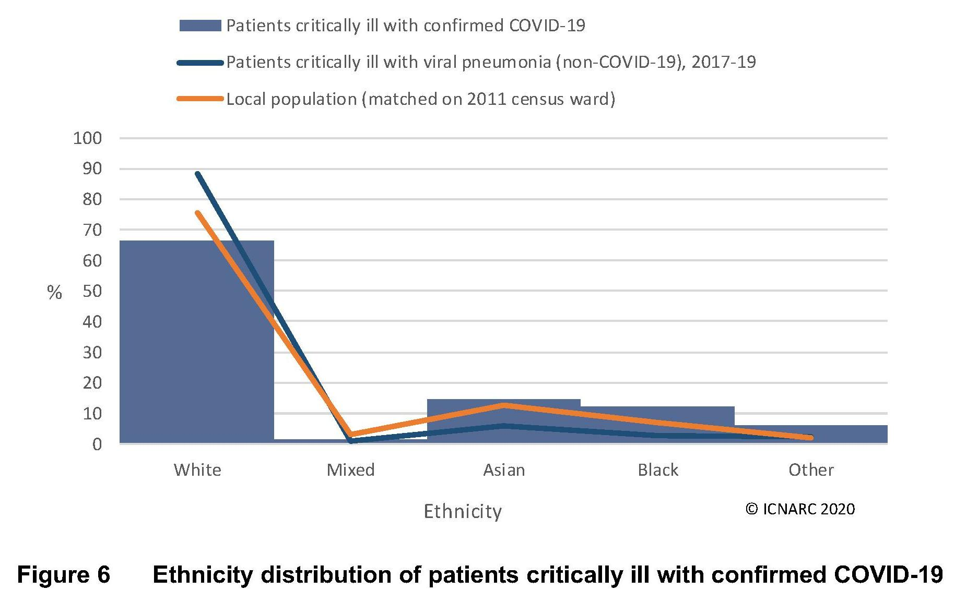
ICNARC - ethnicity
Slide 16

Slide 17
ICNARC – ethnicity table
Slide 17

Slide 18
ICNARC – previous health status
The COVID-19 were healthier before than viral pneumonia patients
Slide 18

Slide 19
Newspaper data - Jews
Jewish Chronicle 27 March
34 deaths / 759 national = 4.5%. Jews ~0.5% population.
Relative age? London concentration?
Jewish Chronicle 8 April
152 deaths / 8,958 UK deaths (9 April, UK Gov website) = 1.6%
Jewish figure includes non-hospital deaths, UK Gov only hospital deaths
Slide 19

Slide 20
Newspaper data - Muslims
Unable to find equivalent data
Muslims heavily over-represented in early NHS medical staff deaths
Guardian 10 April, first 10 named doctors to die, & 3/6 named nurses, BAME backgrounds
Social media suggests Muslim deaths >> population share, but not seen hard facts
Asian % in ICNARC data implies greater Muslim impact
Slide 20

Slide 21
Multigenerational households
Children + parents + grandparents in one house
Very common with Muslims and with Haredi Jews
Do they increase the risk?
Intuitively obvious, but hard evidence not yet in.
Two competing research papers, will provide on MJF website.
Slide 21

Slide 22
Immediate challenges
Slide 22

Slide 23
Burials
Possibly many deaths in short period
Concerns about forced cremation
Muslim & Jewish concerted lobbying achieved changes to Coronavirus Act 2020 Schedule 28 para 13. (See next slide)
Cemeteries are responding
Multiple burials on same day etc.
Slide 23

Slide 24
Coronavirus Act 2020 Sch 20 para 13
13 (1) In carrying out functions under this Schedule, local authorities and the appropriate national authorities must have regard to the desirability of disposing of a dead person’s body or other remains—
(a) in accordance with the person’s wishes, if known, or
(b) otherwise in a way that appears consistent with the person’s religion or beliefs, if known.
(2) In carrying out functions under the legislation listed in sub-paragraph (3), designated local authorities must have regard to the desirability of disposing of a dead person’s body or other remains—
(a) in accordance with the person’s wishes, if known, or (b) otherwise in a way that appears consistent with the person’s religion or beliefs, if known.
Slide 24

Slide 25
Passover and Ramadan
Passover
Much electronic sharing of Passover Seders
Ramadan
Most mosques have recognised communal prayers will not be possible
Slide 25

Slide 26
Sharing experiences of helping those self-isolating
For participants’ contributions
Slide 26

Slide 27
Brainstorming new ideas
For participants’ contributions
Slide 27

