Slide 1
Israel & Palestine One British Muslim’s perspective
1st Annual Rashid Hasan Khan Seminar
This Land is Mine
Mohammed Amin MBE FRSA MA FCA AMCT CTA(Fellow)
25 May 2019

Slide 2
Synopsis
The speaker
Why do I care?
What do I think?
What do I do?
Bibliography

Slide 3
Mohammed Amin
Mohammed Amin has lived in the UK since the age of 2. He graduated in mathematics from Cambridge University and before retirement was a tax partner in PricewaterhouseCoopers.
Amongst other things, he is:
Chairman of the Conservative Muslim Forum, part of the Conservative Party
Co-Chair of the Muslim Jewish Forum of Greater Manchester
Chairman of the Istanbul Network for Liberty
He has visited Israel and Palestine twice.
www.mohammedamin.com
Slide 3

Slide 4
Why do I care?
Slide 4

Slide 5
Should I care?
Against | For
Israel = 150’th country by area | Holiest city for 2.3 bn Christians
Israel = 100’th country by population | 3’rd holiest city for 1.8 bn Muslims
Israel = 33’rd country by GDP | Holiest city for 0.014 bn Jews
Other conflicts have killed many more | Close to Suez Canal & oil states
People care passionately about this conflict for many reasons.
Slide 5

Slide 6
People take sides. In general:
Pro - Israeli | Pro - Palestinian
Jews | Muslims
Christian Zionists | Many other Christian groups
Political Left – in past | Political Left - today
Political Right | Former colonial subjects
Slide 6

Slide 7
What do I think?
Slide 7

Slide 8
For Jews, Israel is about survival
Long European history of persecutions and expulsions
European enlightenment ➔ Equal citizenship
Western European discrimination e.g. Dreyfus Affair
Russia, major pogroms starting ~ 1880
When virtually nobody will take you in
Evian Conference July 1938
Voyage of the St Louis May - June 1939
Slide 8

Slide 9
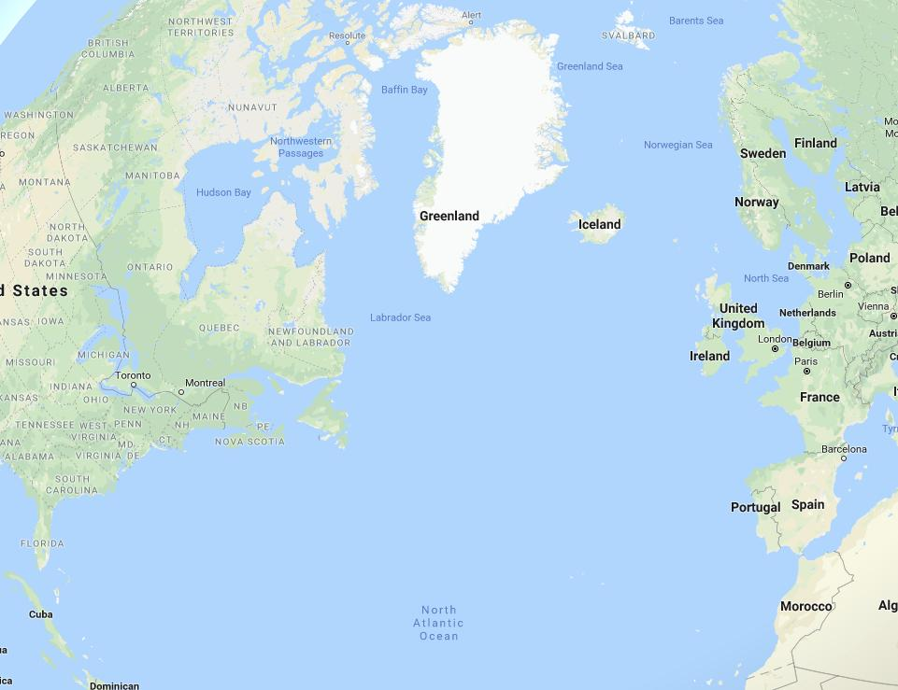
St Louis – May to June 1939
Near UK 29 off by boats
Start Hamburg
Near Canada
620 landed Antwerp
254 traced to Holocaust deaths
Near Florida
Havana 29 off
Slide 9

Slide 10
History (1)
1882 – Jewish immigration to Palestine picks up
1917 – British conquer Palestine from Ottoman Empire
1917 – Balfour Declaration.
Slide 10

Slide 11
The Balfour Declaration
“His Majesty's government view with favour the establishment in Palestine of a national home for the Jewish people, and will use their best endeavours to facilitate the achievement of this object, it being clearly understood that nothing shall be done which may prejudice the civil and religious rights of existing non-Jewish communities in Palestine, or the rights and political status enjoyed by Jews in any other country.”
Letter 2 November 1917 from UK Foreign Secretary Arthur Balfour to Lord Rothschild
Slide 11

Slide 12
History (2)
1929 – Hebron massacre
1936-1939 – Arab revolt
1937 – British partition plan (map follows)
1947 – UN partition plan (map follows)
1948 – War of Independence (map follows)
Slide 12

Slide 13
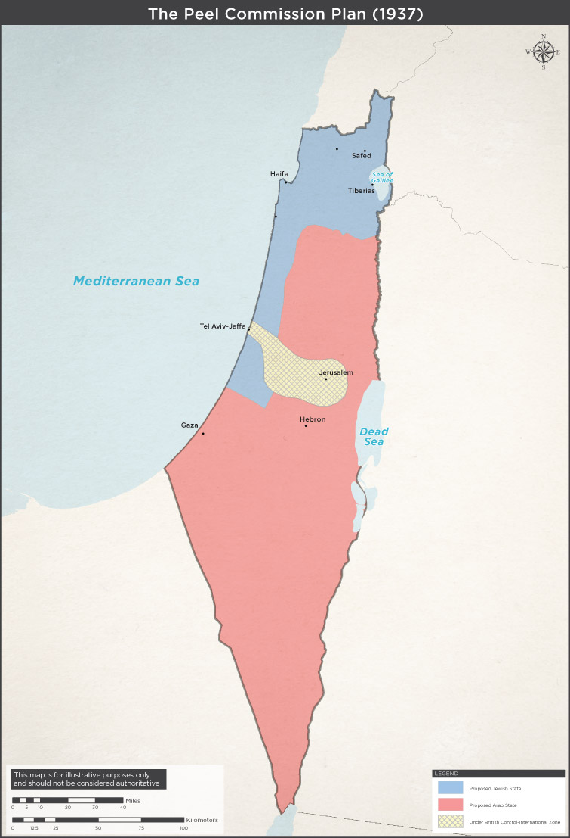
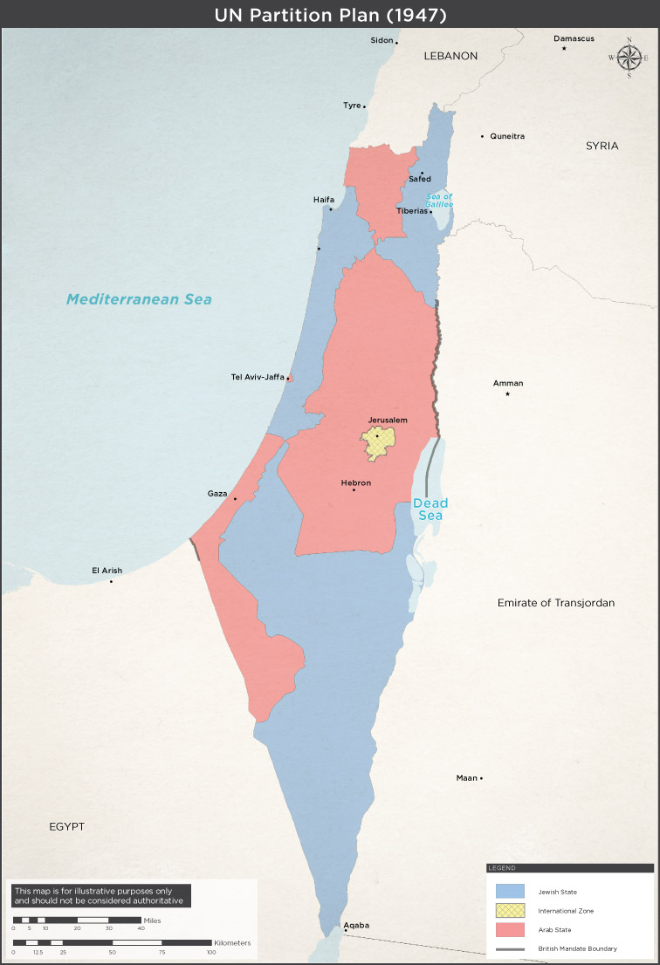
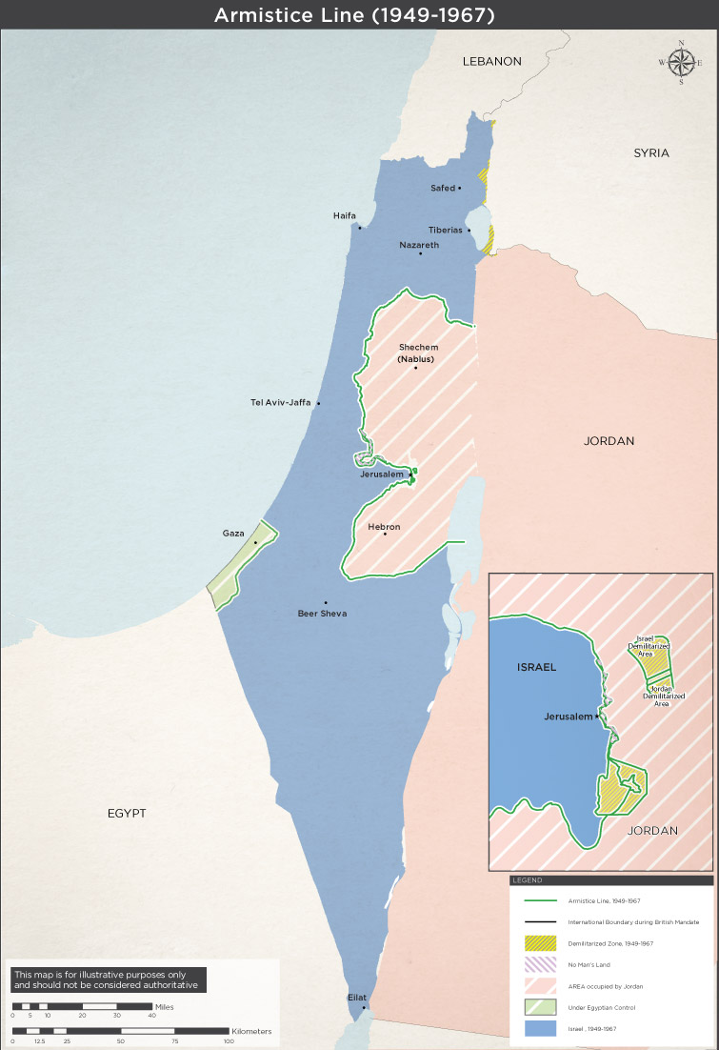
Three maps
Slide 13

Slide 14
History (3)
1967 – Six Day War
1973 – Yom Kippur war
1979 – Egypt / Israel peace treaty
1982 – First Israel / Lebanon war
1987 – Founding of Hamas
1993 – Oslo accords
1994 – Jordan / Israel peace treaty
Slide 14

Slide 15
History (4)
2000 – Start of second Intifada (Uprising)
2005 – Israel evacuates Gaza
2006 – Second Israel / Lebanon War
2007 – Hamas wins Palestinian elections, frozen out
2008 – First Gaza conflict v Hamas
2012 – Second Gaza conflict v Hamas
2014 – Third Gaza conflict v Hamas
Slide 15

Slide 16
Approximate population numbers
Israel, population ~ 8.5m
75% Jewish, 20% Muslim, 5% other.
Palestinians:
West Bank 2.8m
Gaza 1.8m
Diaspora ~6m, mainly in Arab states
Slide 16

Slide 17
Palestine Liberation Organisation’s objectives
End the occupation
A state comprising West Bank and Gaza
Demilitarisation?
Jerusalem?
Preserve the demand for the right of return
Slide 17

Slide 18
Palestinian acts of self-harm
Promoting hatred of Israel
Honouring terrorists
Paying stipends to families of terrorists
Clinging to the myth of return
Despite Oslo Accords, unwillingness to accept permanence of Israel
Slide 18

Slide 19
Hamas (Islamic Resistance Movement)
The Covenant of the Islamic Resistance Movement 18 August 1988 on Yale Law School website http://avalon.law.yale.edu/20th_century/hamas.asp
May 2017 update on Middle East Eye website http://www.middleeasteye.net/news/hamas-charter-1637794876
Slide 19

Slide 20
What Hamas says itself
Every cm² of Palestine must be Muslim controlled
Has only ever offered time-limited truce
Slide 20

Slide 21
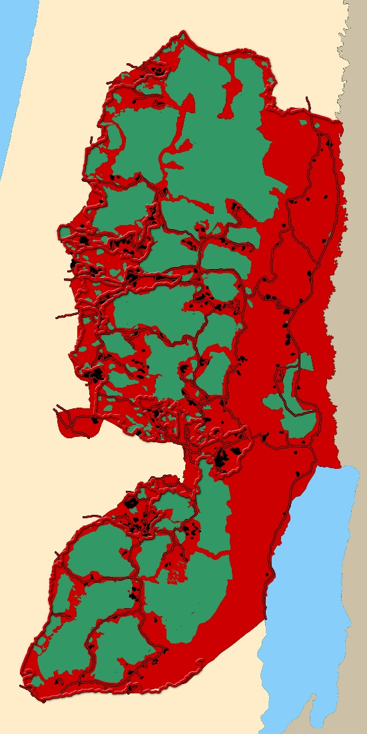
The West Bank today, simplified
Red = areas under Israeli control
From “The Palestine Teaching Trunk” - teaching materials for in western Washington State high schools
Slide 21

Slide 22
Israel’s trilemma
Majority of Jewish voters
Apartheid state
Two state solution
Choose one side of triangle
Keep all occupied lands
Fully democratic state
Jewish & Arab
Bi-national state
Slide 22

Slide 23
What do I do?
Slide 23

Slide 24
Be precise with my language
25% of Israeli citizens are not Jewish
20% are Muslim
I call them “the forgotten Israelis”
My vocabulary
Israeli = any citizen of Israel
Otherwise, Israeli Jews / Israeli Arabs
“West Bank Palestinians” / “Gazan Palestinians”
Slide 24

Slide 25
Support shared citizenship in Israel
Israeli Arabs nominally almost equal citizens
Private sector discrimination + some state discrimination
I support several Israeli NGOs including:
The New Israel Fund
The Abraham Initiatives
Merchavim - the Institute for the Advancement of Shared Citizenship in Israel
Oasis of Peace UK: British Friends of Neve Shalom / Wahat al-Salam
Rabbis for Human Rights
Slide 25

Slide 26
Support work for Israeli / Palestinian Peace
Many NGOs working to bridge the Green Line (Israel / West Bank) divide. E.g.
Children of Peace
OneVoice Europe
The Bereaved Families Forum
Windows for Peace
Slide 26

Slide 27
Support balanced debate in UK
CAABU = Council for the Advancement of Arab-British Understanding
FODIP = The Forum for Discussion of Israel and Palestine
Slide 27

Slide 28
Bibliography
Slide 28

Slide 29
Books (1)
"In Ishmael’s House – A History of Jews in Muslim Lands" by Martin Gilbert
“The Invention of the Jewish People” by Shlomo Sand
"The Jewish State" by Theodor Herzl
"Old New Land (Altneuland)" by Theodor Herzl
“The Balfour Declaration: The Origins of the Arab-Israeli Conflict” by Jonathan Schneer .
"The Road to Mecca" by Muhammad Asad
Slide 29

Slide 30
Books (2)
"1948: A History of the First Arab-Israeli War" by Benny Morris
“The Ethnic Cleansing of Palestine” by Ilan Pappe
“Once Upon a Country: A Palestinian Life” by Sari Nusseibeh
"The Israel lobby and US foreign policy" by John J. Mearsheimer and Stephen M. Walt
“Israel and Palestine: Why They Fight and Can They Stop?” by Bernard Wasserstein
"How to Cure a Fanatic – Israel and Palestine: Between Right and Right" by Amos Oz
"Palestinian Walks: Notes on a Vanishing Landscape" by Raja Shehadeh
Slide 30

Slide 31
Q & A

