Slide 1
Antisemitism: Presentation & Discussion
Liberal Democrats for Peace in the Middle East
Mohammed Amin MBE FRSA MA FCA AMCT CTA(Fellow)
11 September 2023

Slide 2
Outline
The presenter
Definitions matter
The IHRA definition
The IHRA examples
When does anti-Zionism become antisemitism?
Case studies
Recommended reading
Discussion
2

Slide 3
The speaker
3

Slide 4
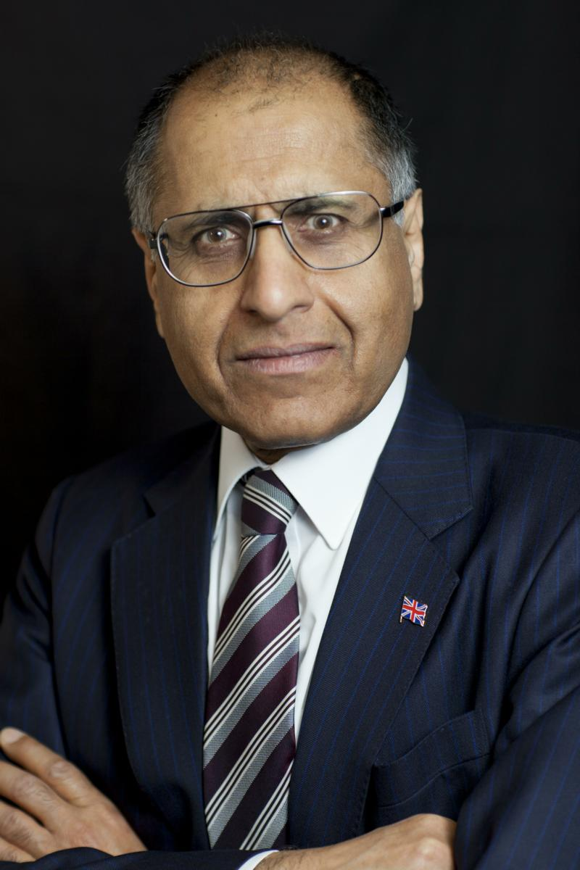
Mohammed Amin
Mohammed Amin was born in 1950 in Pakistan but has lived in Manchester since 1952. He graduated in mathematics from Cambridge University and before retirement was a tax partner in PricewaterhouseCoopers.
He is:
Vice-Chairman of LDfPME
Co-Chair of the Muslim Jewish Forum of Greater Manchester
Chairman of the Council of the Islam & Liberty Network
Chairman of the National Muslim War Memorial Trust
He is speaking in a personal capacity.
www.mohammedamin.com
4

Slide 5
Definitions matter
5

Slide 6
Field
6

Slide 7
Field
A field is any set of elements that satisfies the field axioms (below) for both addition and multiplication and is a commutative division algebra.
Name | Addition | Multiplication
associativity | (a+b)+c=a+(b+c) | (a·b)·c=a·(b·c)
commutativity | a+b=b+a | a·b=b·a
distributivity | a·(b+c)=a·b+a·c | (a+b)·c=a·c+b·c
identity | a+0=a=0+a | a·1=a=1·a
inverses | a+(-a)=0=(-a)+a | a·a^(-1)=1=a^(-1)·a if a≠0
Source: https://mathworld.wolfram.com/Field.html
7

Slide 8
The IHRA definition
8

Slide 9
International Holocaust Remembrance Alliance
“Uniting governments and experts to strengthen, advance, and promote Holocaust education, remembrance, and research worldwide and to uphold the commitments of the 2000 Stockholm Declaration and the 2020 Ministerial Declaration.”
35 member countries: Argentina, Australia, Austria, Belgium, Bulgaria, Canada, Croatia, Czech Republic, Denmark, Estonia, Finland, France, Germany, Greece, Hungary, Ireland, Israel, Italy, Latvia, Lithuania, Luxembourg, Netherlands, North Macedonia, Norway, Poland, Portugal, Romania, Serbia, Slovakia, Slovenia, Spain, Sweden, Switzerland, United Kingdom, United States of America.
9

Slide 10
Non-legally binding working definition of antisemitism
“Antisemitism is a certain perception of Jews, which may be expressed as hatred toward Jews. Rhetorical and physical manifestations of antisemitism are directed toward Jewish or non-Jewish individuals and/or their property, toward Jewish community institutions and religious facilities.”
Source:
https://www.holocaustremembrance.com/sites/default/files/press_release_document_antisemitism.pdf
10

Slide 11
Spelling
It is antisemitism, not anti-Semitism or anti-semitism
IHRA uses antisemitism
There is no such thing as “Semitism”!
Read “Should Anti-Semitism Be Hyphenated?” at https://forward.com/culture/166092/should-anti-semitism-be-hyphenated/
11

Slide 12
Can you be antisemitic towards Arabs?
Arabs speak a Semitic language (= Semites) as do Jews
Trying to include Arabs perpetrates the etymological fallacy
See https://en.wikipedia.org/wiki/Etymological_fallacy
12

Slide 13
The IHRA examples
13

Slide 14
Introduction to the examples
“To guide IHRA in its work, the following examples may serve as illustrations:
Manifestations might include the targeting of the state of Israel, conceived as a Jewish collectivity. However, criticism of Israel similar to that leveled against any other country cannot be regarded as antisemitic. Antisemitism frequently charges Jews with conspiring to harm humanity, and it is often used to blame Jews for “why things go wrong.” It is expressed in speech, writing, visual forms and action, and employs sinister stereotypes and negative character traits.
Contemporary examples of antisemitism in public life, the media, schools, the workplace, and in the religious sphere could, taking into account the overall context, include, but are not limited to:”
14

Slide 15
The examples (1)
Calling for, aiding, or justifying the killing or harming of Jews in the name of a radical ideology or an extremist view of religion.
Making mendacious, dehumanizing, demonizing, or stereotypical allegations about Jews as such or the power of Jews as collective — such as, especially but not exclusively, the myth about a world Jewish conspiracy or of Jews controlling the media, economy, government or other societal institutions.
Accusing Jews as a people of being responsible for real or imagined wrongdoing committed by a single Jewish person or group, or even for acts committed by non-Jews.
15

Slide 16
The examples (2)
Denying the fact, scope, mechanisms (e.g. gas chambers) or intentionality of the genocide of the Jewish people at the hands of National Socialist Germany and its supporters and accomplices during World War II (the Holocaust).
Accusing the Jews as a people, or Israel as a state, of inventing or exaggerating the Holocaust.
Accusing Jewish citizens of being more loyal to Israel, or to the alleged priorities of Jews worldwide, than to the interests of their own nations.
16

Slide 17
The examples (3)
Denying the Jewish people their right to self-determination, e.g., by claiming that the existence of a State of Israel is a racist endeavor.
Applying double standards by requiring of it a behavior not expected or demanded of any other democratic nation.
Using the symbols and images associated with classic antisemitism (e.g., claims of Jews killing Jesus or blood libel) to characterize Israel or Israelis.
Drawing comparisons of contemporary Israeli policy to that of the Nazis.
Holding Jews collectively responsible for actions of the state of Israel.
17

Slide 18
Home Affairs Select Committee 2015
“Antisemitism in the UK”
https://publications.parliament.uk/pa/cm201617/cmselect/cmhaff/136/13605.htm
Recommended adding
It is not antisemitic to criticise the Government of Israel, without additional evidence to suggest antisemitic intent.
It is not antisemitic to hold the Israeli Government to the same standards as other liberal democracies, or to take a particular interest in the Israeli Government’s policies or actions, without additional evidence to suggest antisemitic intent.
18

Slide 19
When does anti-Zionism become antisemitism?
19

Slide 20
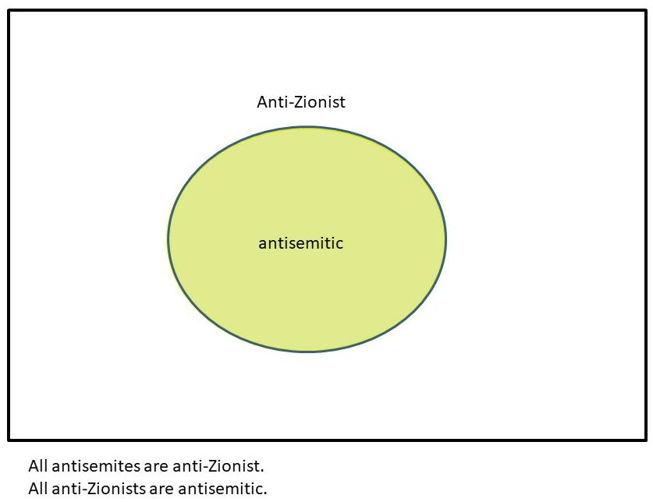
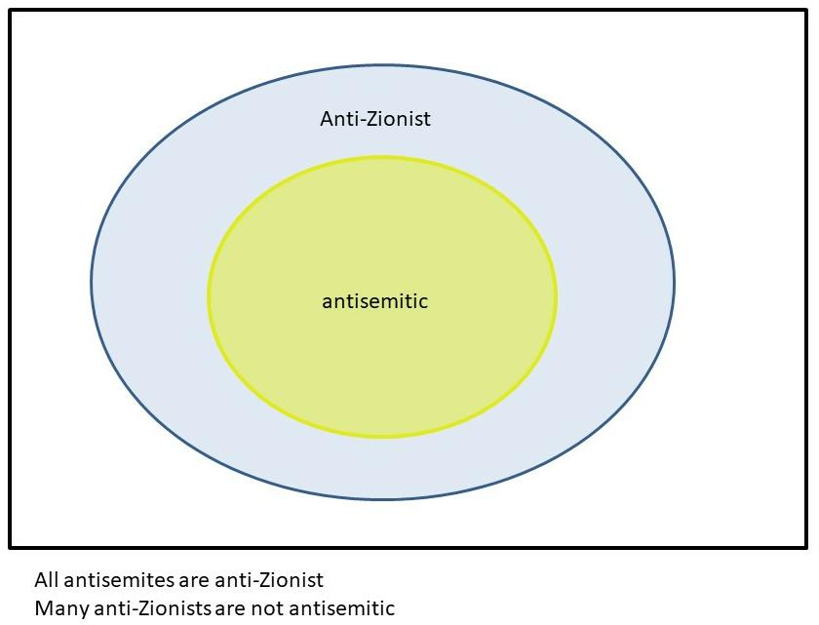
Two alternative propositions
?
20

Slide 21
What is Zionism?
“The World Zionist Organization was founded at the initiative of Theodore Herzl at the First Zionist Congress which took place in August 1897 in Basle, Switzerland.
When it was founded, the goals of the Zionist movement were stated in a resolution that came of that Congress and came to be known as the “Basle Program.”
Zionism aims at establishing for the Jewish people a legally assured home in Eretz Yisrael.
Source https://www.wzo.org.il/page/about/mission-statement/en
21

Slide 22
Can you be anti-Zionist in 2023?
Zionism’s goal was accomplished in 1948
What does anti-Zionism mean now?
Many possible definitions of anti-Zionism
I offered three in 2014
22

Slide 23
Anti-Zionism-A
Belief that the Basle Program could not be accomplished without overriding the rights of the Palestinians who already lived in the land.
Acceptance that historical wrongs occurred and were committed by both parties.
Acceptance that the State of Israel exists today with a 75% Jewish majority and that this is a legal and historical fact that cannot be reversed without further injustice to many people. The borders of the State of Israel to be negotiated and agreed with the Palestinians, with the 1949 armistice line as the starting point of the negotiations.
Pretty mild ➔ lots of people share this view
23

Slide 24
Anti-Zionism-A
All antisemites are anti-Zionist-A.
Many anti-Zionists-A are not antisemitic.
Anti-Zionist-A
antisemitic
24

Slide 25
Anti-Zionism-B
Belief that separation between Jews living in the West Bank and Palestinians is no longer possible.
Belief that a single binational state from the Mediterranean to the Jordan is the only just solution, even if this results in an eventual Arab majority in the state due to demographic change.
Stronger ➔ fewer people share this view
25

Slide 26
Anti-Zionism-B
All antisemites are anti-Zionist-B.
Some anti-Zionists-B are not antisemitic.
Anti-Zionist-B
antisemitic
26

Slide 27
Anti-Zionism-C
Belief that the immigration of European Jews (and Jews from Arab countries) into Palestine was so wrong that it should be reversed, with the Jewish population expelled so that Palestine becomes an entirely non-Jewish state.
Very strong ➔ only antisemites people share this view
27

Slide 28
Anti-Zionism-C
All antisemites are anti-Zionist-C.
All anti-Zionists-C are antisemitic.
Anti-Zionist-C
Blue circle and yellow circle overlap completely = green
antisemitic
28

Slide 29
Case studies
29

Slide 30
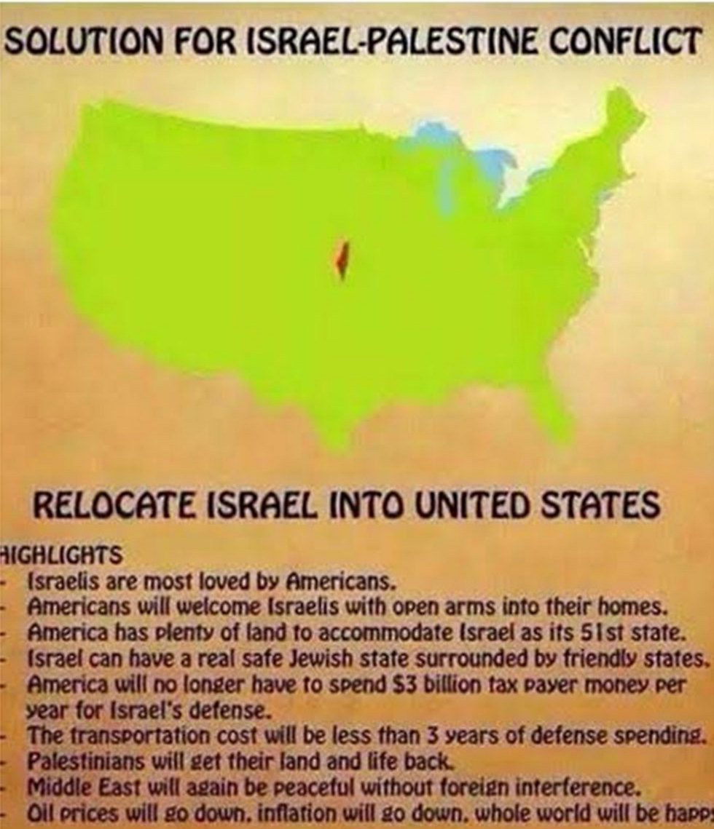
Image shared by Naz Shah MP
Shared on Facebook 2014 (before becoming an MP) with comment “Job done.”
Source:
https://www.ynetnews.com/articles/0,7340,L-4796470,00.html
30

Slide 31
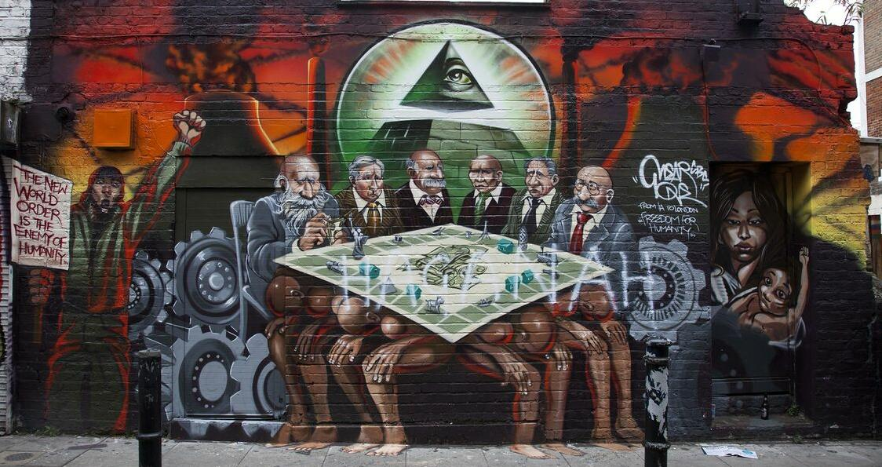
“Freedom for Humanity” by Mear One
31

Slide 32
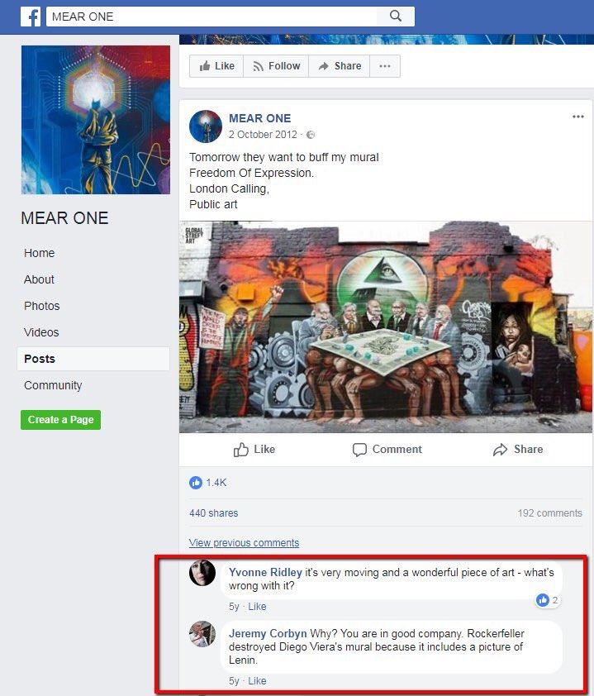
Facebook screenshot
Tower Hamlets Council ordered mural to be painted over after complaints.
Jeremy Corbyn MP couldn’t see anything wrong with it.
32

Slide 33
Recommended reading
33

Slide 34
Some books
“Old New Land (Altneuland)” by Theodor Herzl
“The Left's Jewish Problem - Jeremy Corbyn, Israel and Anti-Semitism” by Dave Rich
“The Protocols of the Learned Elders of Zion”
34

Slide 35
Discussion
35

